Slide 1
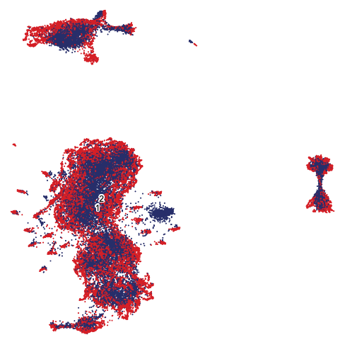
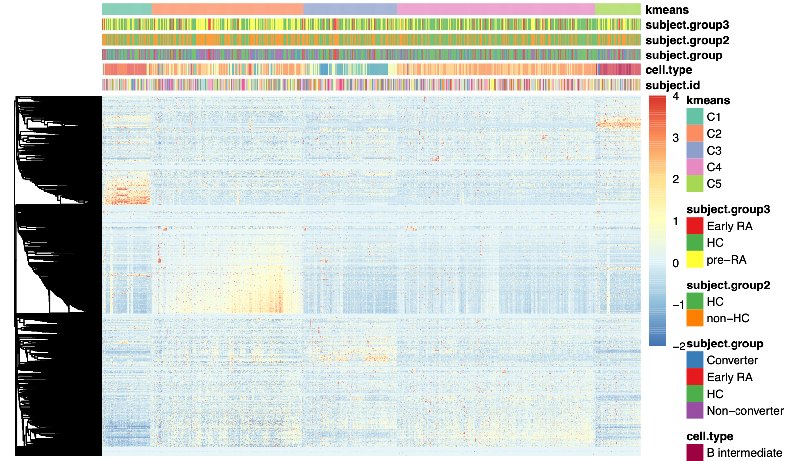
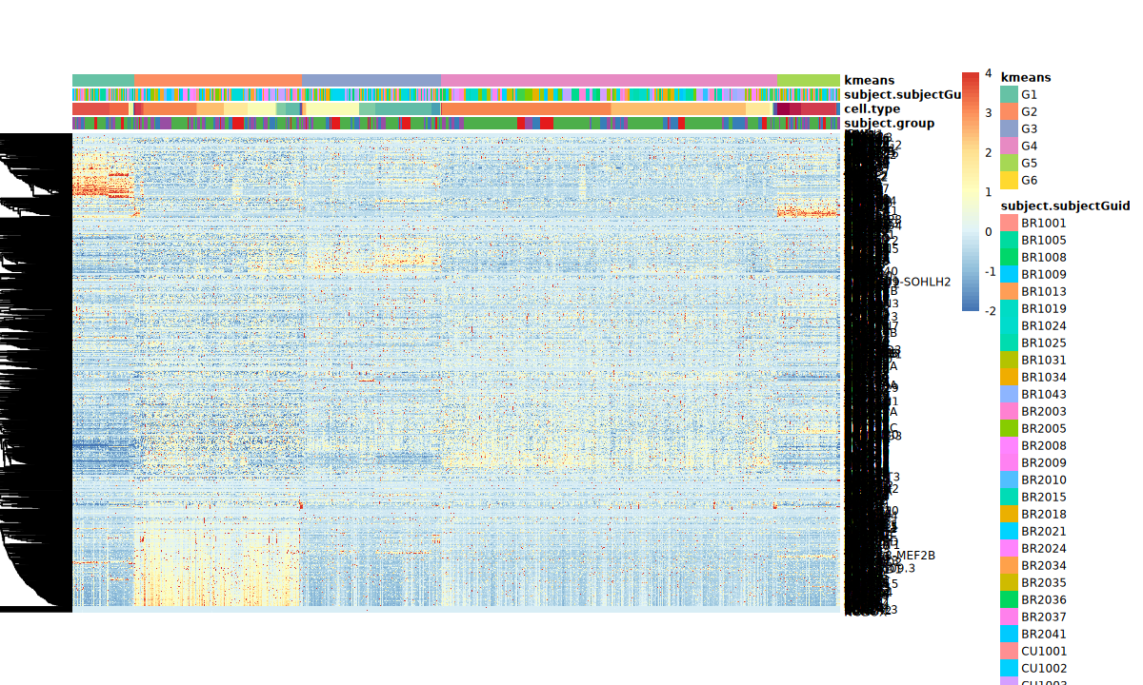
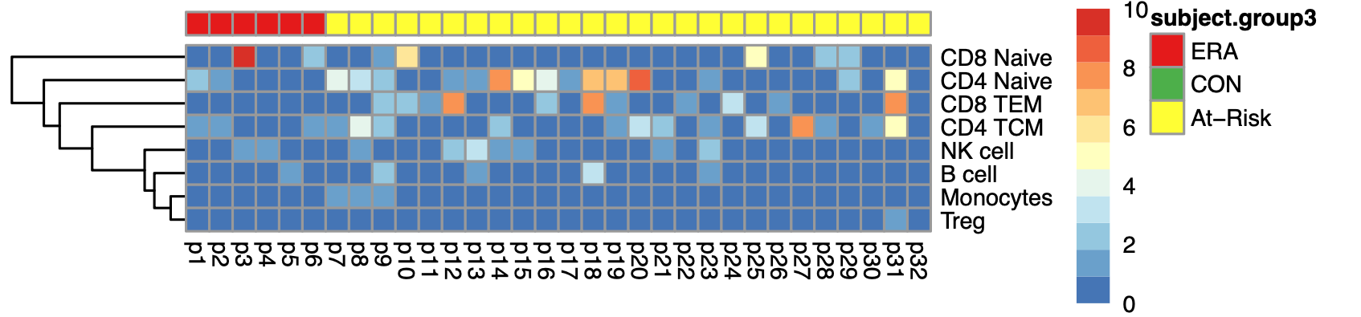
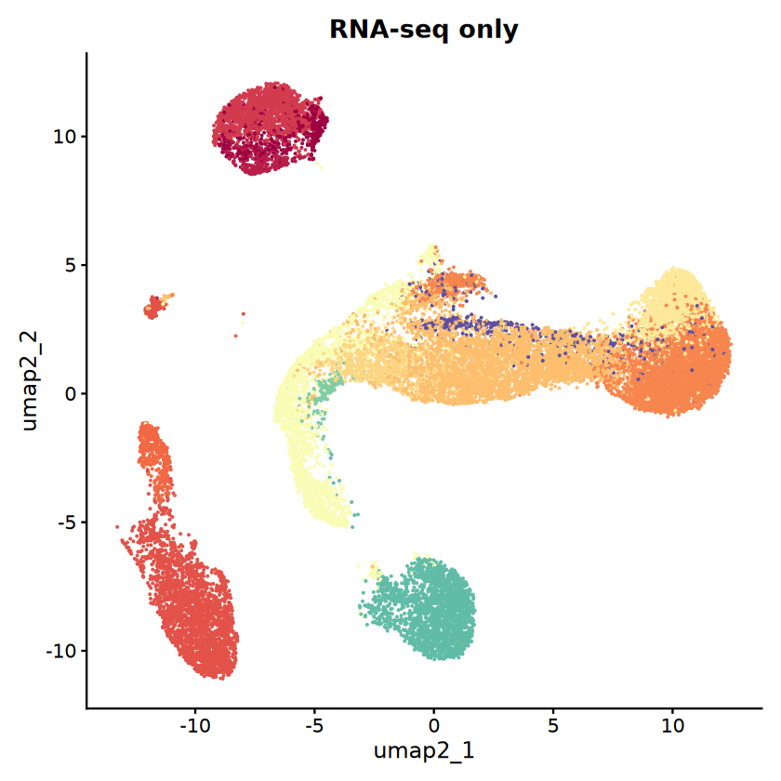
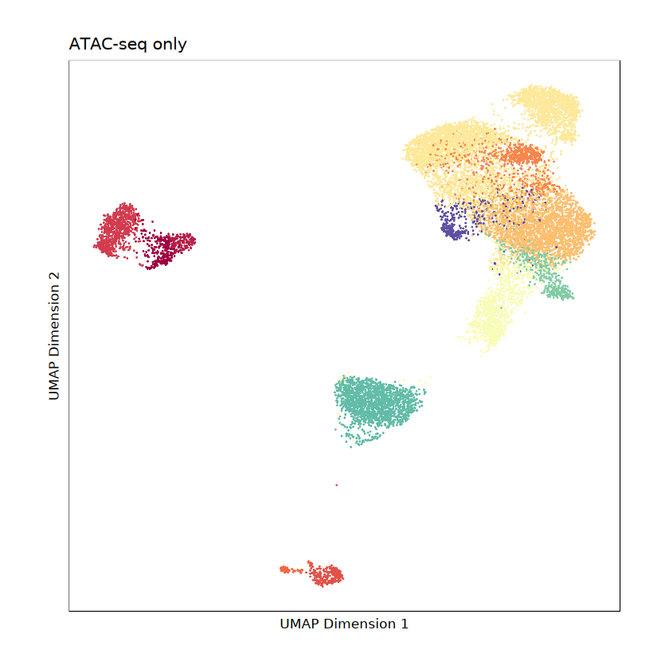
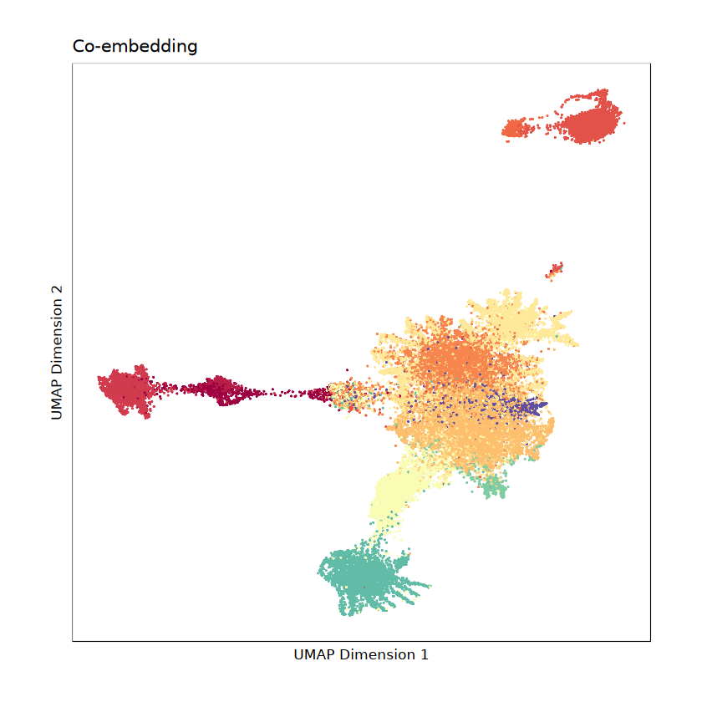
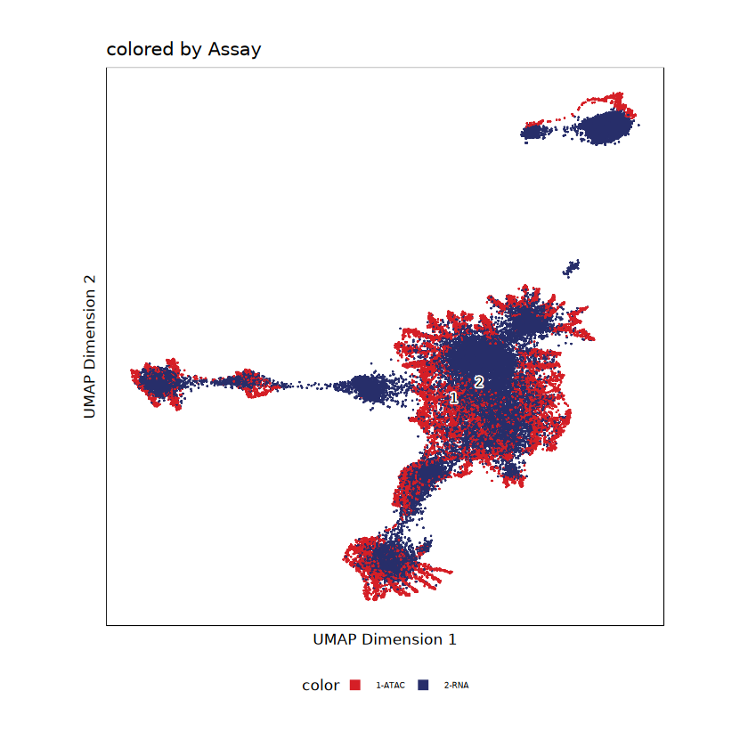
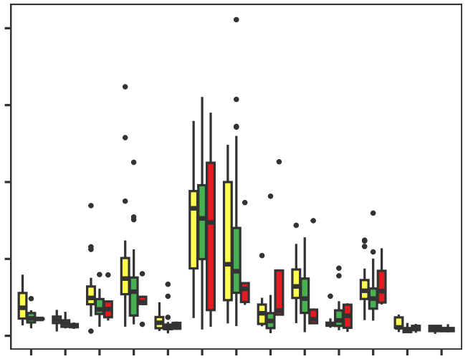
A
Study workflow
scTaiji
Downstream analysis
Datasets
1. Co-embedding
1. Unsupervised clustering shows At-Risk/ERA signature
CD14 Mono
At-Risk/ERA enriched group
Control enriched group
B
naive
CD4 T Naive
RNA
67 PBMC samples
35 Control
26 At-Risk
6 ERA
B
memory
CD16 Mono
CD8 TEM
ATAC
NK
CD4 TCM
TF activity score
MAIT
CD8 T Naive
2. Aggregate cells
gene count
2. At-Risk/ERA signature across multiple cell types
cell
2
0
3
1
1
0
0
2
1
2
0
4
0
1
3
2
4
5
3
ERA
At-Risk
scRNA-seq (n=67)
scATAC-seq (n=67)
CD8 T Naive
3. Predict TF activity score
CD4 T Naive
CD8 TEM
CD4 TCM
NK cell
B cell
# of clusters
Monocytes
D
Percent of cells across cell types
B
scRNA-seq and scATAC-seq of one At-Risk sample
cell types | % of cells
B intermediate | 1.83
B memory | 1.38
B naive | 8.47
CD14 Mono | 11.06
CD16 Mono | 1.80
CD4 T Naive | 25.72
CD4 TCM | 21.31
CD8 T Naive | 3.47
CD8 TEM | 10.33
MAIT | 2.46
NK | 10.73
NK_CD56bright | 0.58
Treg | 0.29
Others | 0.56
scRNA-seq only
scATAC-seq only
B intermediate
B memory
B naive
CD14 Mono
CD16 Mono
CD4 T Naive
CD4 TCM
CD8 T Naive
CD8 TEM
MAIT
NK
NK_CD56bright
Treg
UMAP 2
UMAP 2
UMAP 1
UMAP 1
C
Co-embedding of scRNA-seq and scATAC-seq in one At-Risk sample
Co-embedding colored by cell types
Co-embedding colored by assay
E
Cell type distribution across groups
scATAC-seq
80
CON
scRNA-seq
60
At-Risk
Percent of labelled cells
ERA
UMAP 2
UMAP 2
40
20
*
B intermediate
B memory
B naive
CD14 Mono
CD16 Mono
CD4 T Naive
CD4 TCM
CD8 T Naive
CD8 TEM
MAIT
NK
NK_CD56bright
Treg
0
**
*
UMAP 1
UMAP 1
Notes:
B111_PB00443: CU1033, at-risk, converter
Fig.1D: legend, if there’s difference between three groups, data for each group, can be a table
**p<=0.05, Kruskal-Wallis test

Slide 2
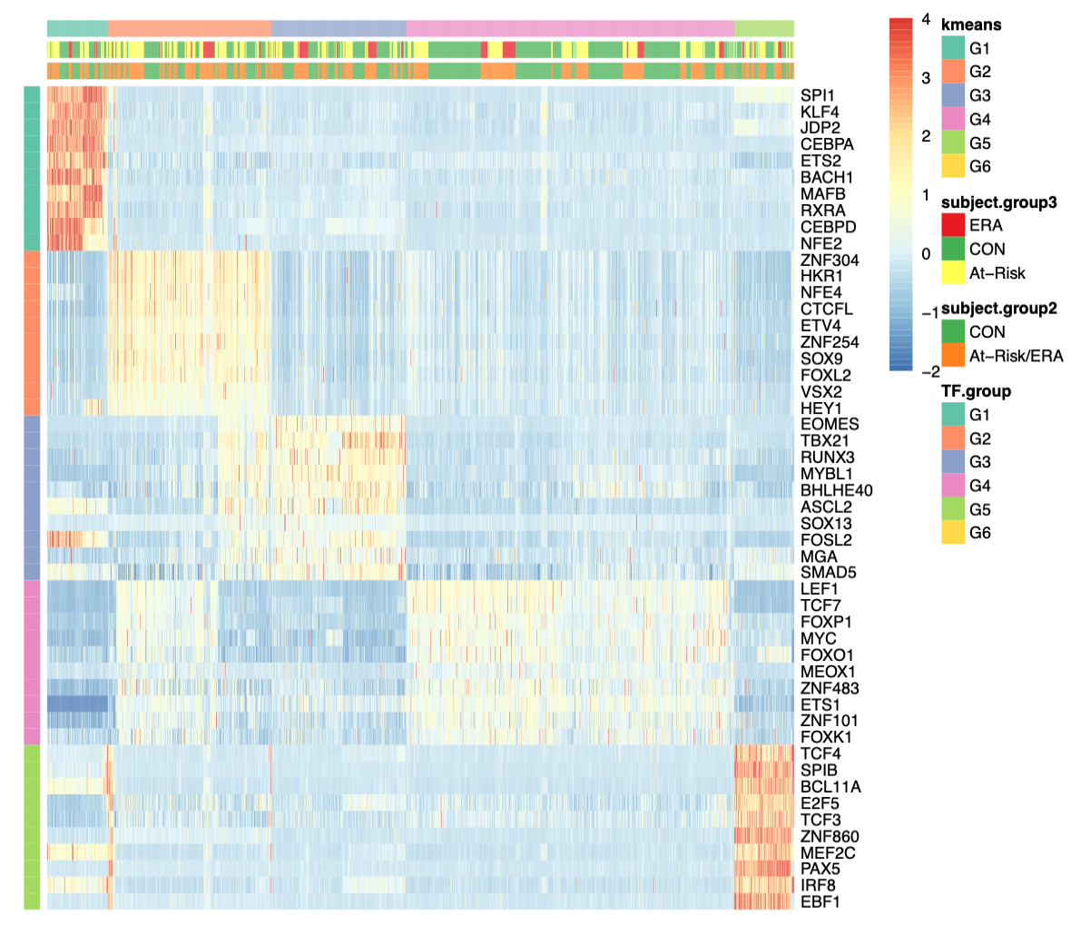
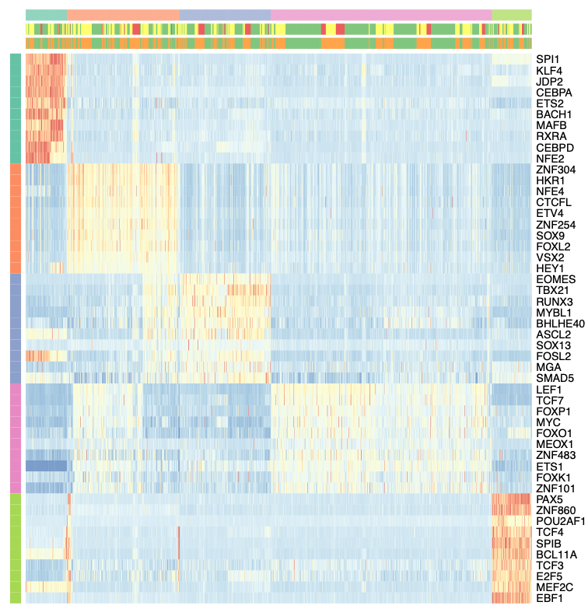
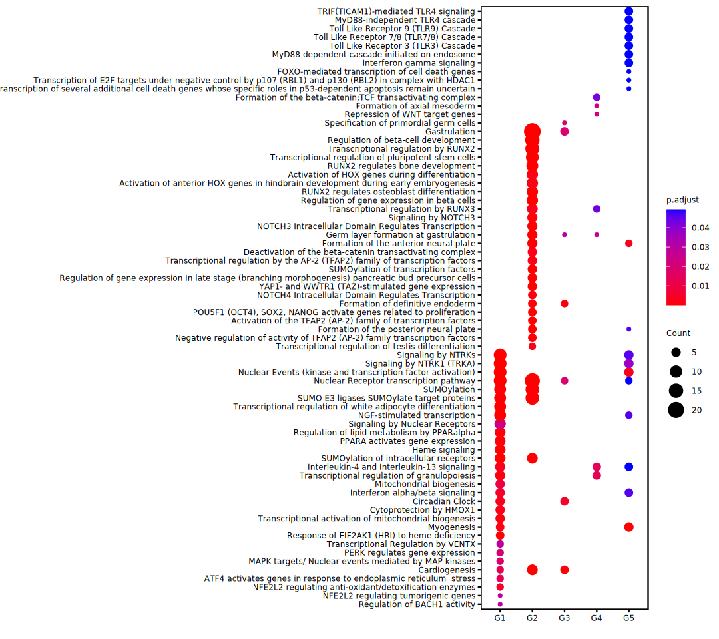
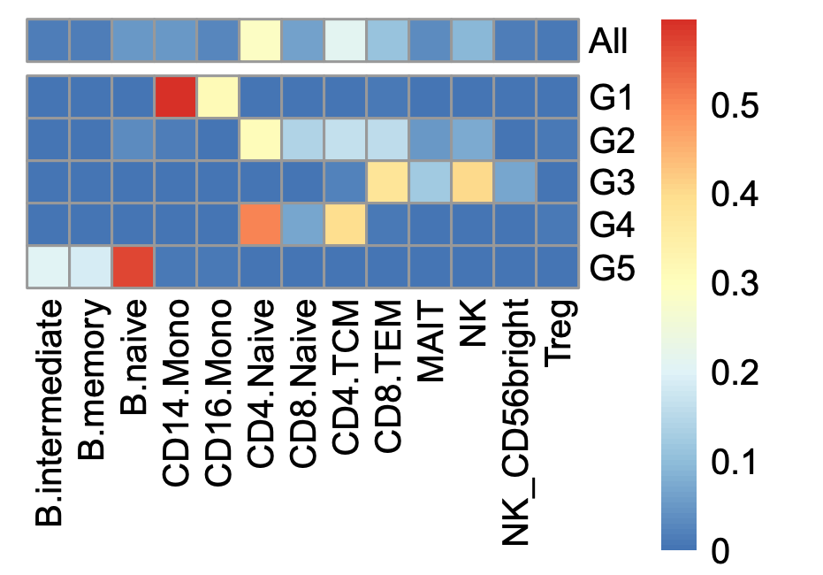
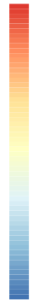
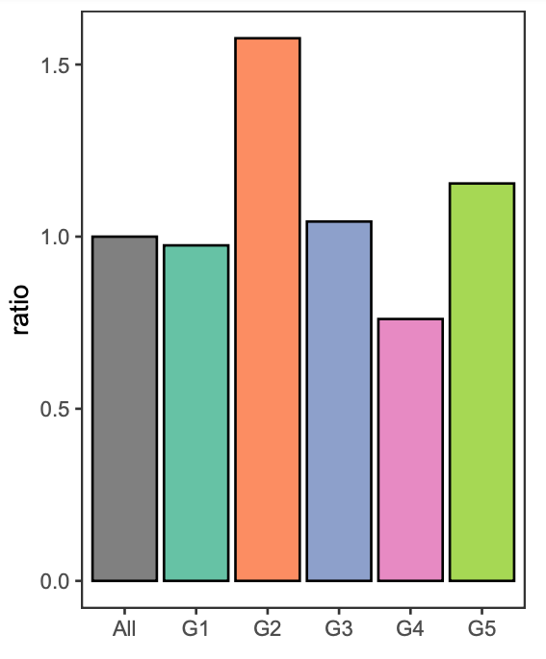
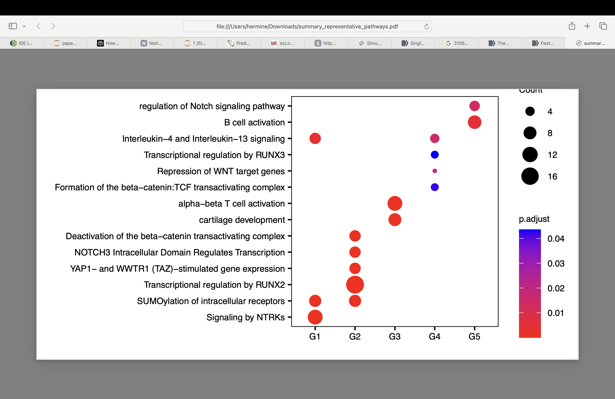
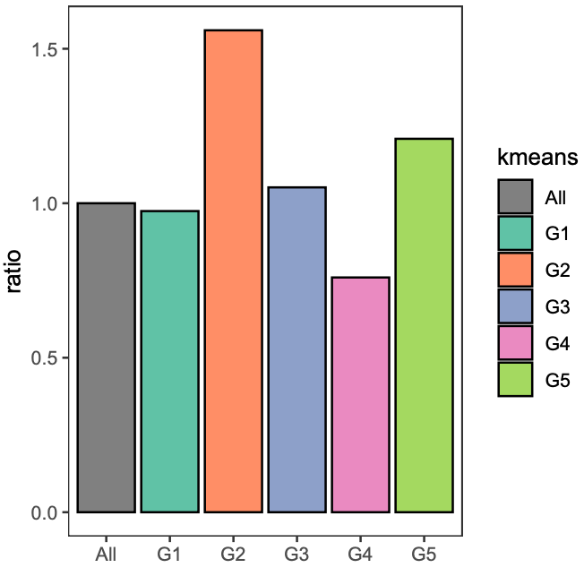
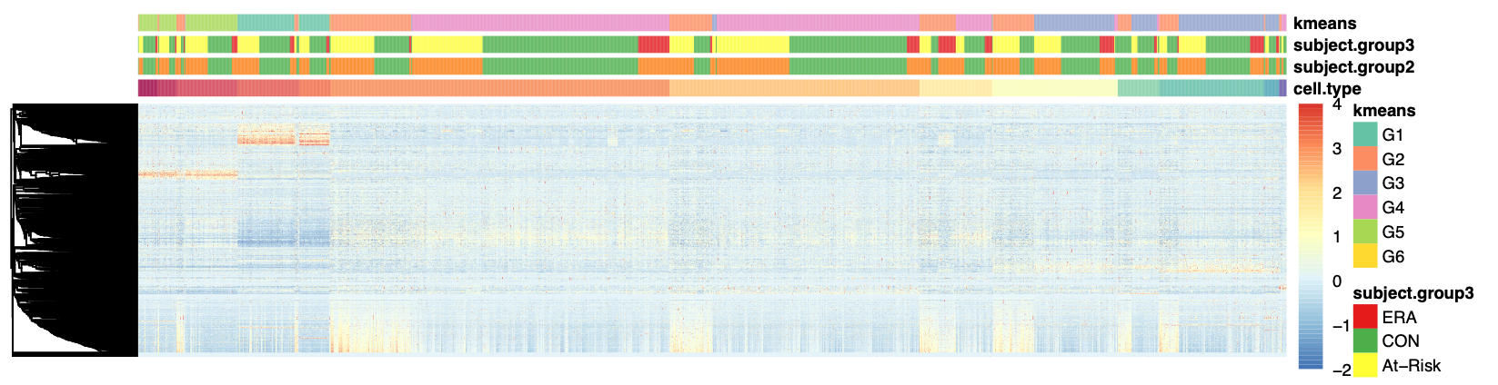
A
Top 10 Kmeans group-specific TFs’ PageRanks
G1
G2
G3
G4
G5
Group | # of specific TFs | # of clusters
G1 | 141 | 131
G2 | 409 | 359
G3 | 65 | 290
G4 | 41 | 704
G5 | 101 | 126
total | 640 | 1610
KLF4
ZNF304
EOMES
TBX21
B
Cell type distribution
LEF1
All
0.5
TCF7
G1
G2
Percent of clusters
G3
0.25
G4
NK
G5
0
SPIB
B naive
MAIT
Treg
CD8 TEM
B memory
CD4 TCM
CD14 Mono
CD16 Mono
CD4 T Naive
B intermediate
CD8 T Naive
NK_CD56bright
Cluster 2
Normalized PageRank scores
Cluster 1
-2
0
2
4
C
At-Risk/ERA enrichment
D
Representative pathways of Kmeans group specific TFs
1.5
****
Regulation of Notch signaling pathway
B cell activation
Interleukin-4 and Interleukin-13 signaling
Transcriptional regulation by RUNX3
Repression of WNT target genes
Formation of the beta-catenin: TCF transactivating complex
Alpha-beta T cell activation
Cartilage development
Deactivation of the beta-catenin transactivating complex
NOTCH3 Intracellular Domain Regulates Transcription
YAP1- and WWTR1 (TAZ)-stimulated gene expression
Transcriptional regulation by RUNX2
SUMOylation of intracellular receptors
Signaling by NTRKs
Count
4
8
12
At-Risk/ERA vs CON ratio
16
1
p.adjust
***
0.04
0.03
0.50
0.02
0
0.01
0
All
G1
G2
G3
G4
G5
G1
G2
G3
G4
G5
E
Multiple cell types show signature
CD8 T Naive
B cell
Monocytes
CD4 T Naive
CD4 TCM
CD8 TEM
MAIT
NK cell
Treg
Normalized PageRank score
-2
0
2
4
Signature TFs
Notes:
*p<=0.1
****p<=1e-4
Fig.2C, the o.g. one, try (non-CON - CON)/CON

Slide 3
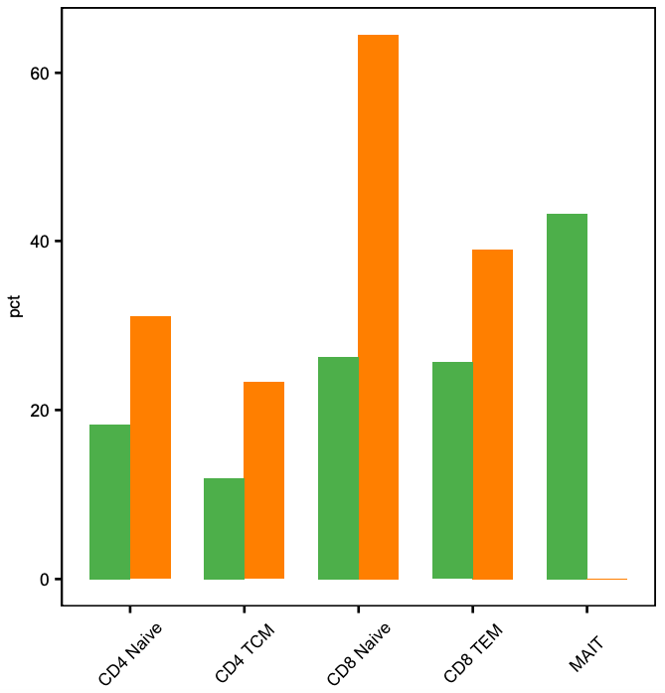
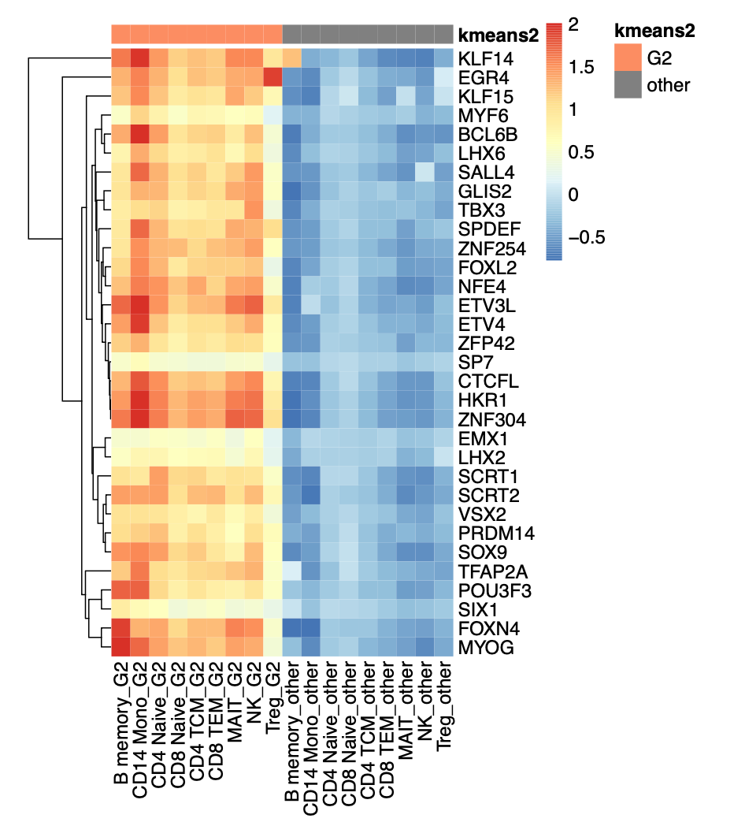
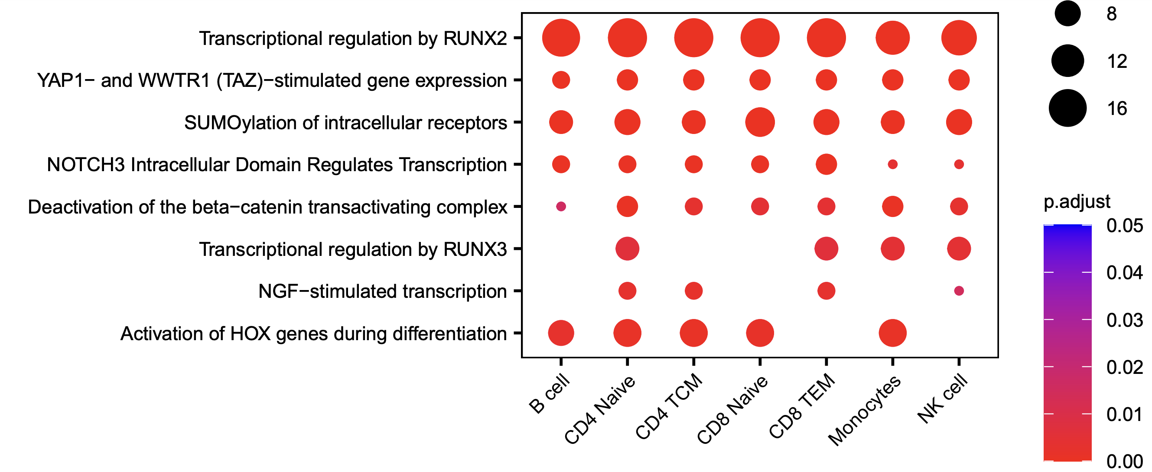
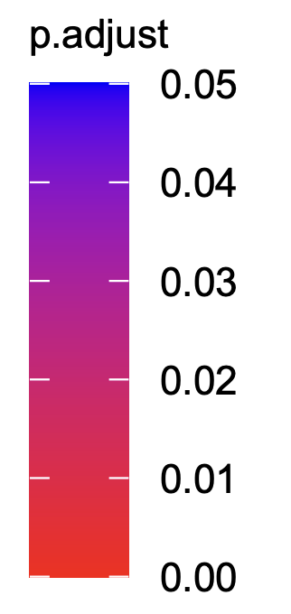
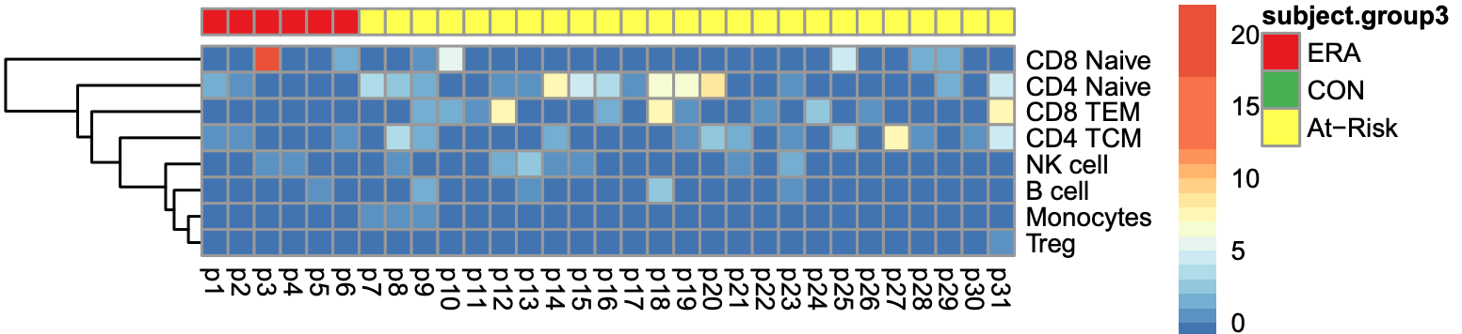
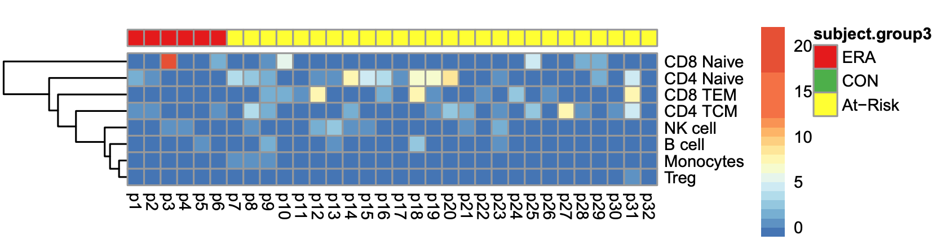
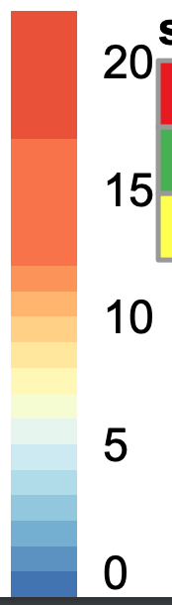
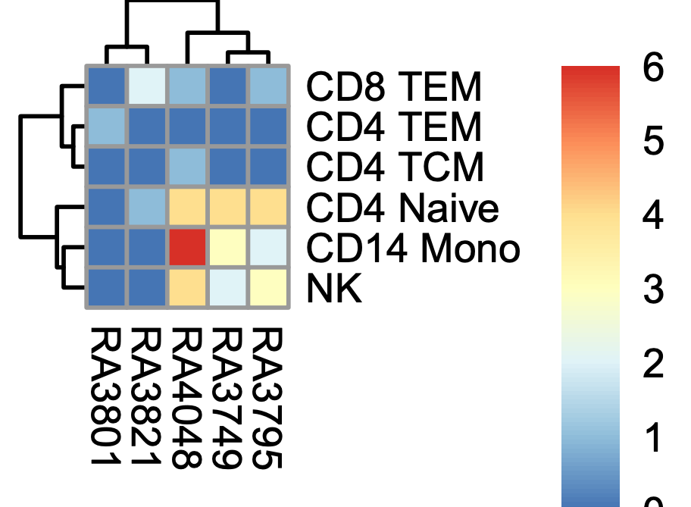
A
G2 clusters ratio per cell type in CON and At-Risk/ERA respectively
B
Mean PageRank of top G2-specific TFs across cell types
G2
other
KLF14
60
***
EGR4
40
*
Normalized PageRank
***
CON
2
Percentage of G2 clusters per cell type
***
At-Risk/ERA
ZNF304
1
20
B memory
CD14 Mono
CD4 T Naive
CD8 T Naive
CD4 TCM
CD8 TEM
MAIT
NK
Treg
B memory
CD14 Mono
CD4 T Naive
CD8 T Naive
CD4 TCM
CD8 TEM
MAIT
NK
Treg
0
0
MYOG
CD4 T Naive
CD4 TCM
CD8 TEM
MAIT
CD8 T Naive
C
Representative G2 pathways across cell types
Transcriptional regulation by RUNX2
count
p.adjust
YAP1- and WWTR1 (TAZ)-stimulated gene expression
4
SUMOylation of intracellular receptors
8
0.04
NOTCH3 Intracellular Domain Regulates Transcription
12
0.02
Deactivation of the beta-catenin transactivating complex
16
0
Transcriptional regulation by RUNX3
NGF-stimulated transcription
Activation of HOX genes during differentiation
B cell
CD4 TCM
CD8 TEM
NK cell
CD4 T Naive
CD8 T Naive
Monocytes
D
Heatmap of participants in G2 across cell types
ERA
At-Risk
CD8 T Naive
Number of G2 clusters
CD4 T Naive
>=10
CD8 TEM
CD4 TCM
5
NK cell
B cell
0
Monocytes
p10
p11
p12
p13
p14
p15
p16
p17
p18
p19
p20
p21
p22
p23
p24
p25
p26
p27
p28
p29
p30
p31
p1
p32
p2
p3
p4
p5
p6
p7
p8
p9
E
Signature clusters in established RA PBMC samples
F
Signature TF overlap
G
Enriched pathways overlap
Number of G2 clusters
At-Risk/ERA
0
CD8 TEM
6
Established RA
Established RA
At-Risk/ERA
5
10
15
20
CD4 TEM
5
CD4 TCM
4
CD4 T Naive
3
94
276
157
5
27
19
CD14 Mono
2
Number of signature clusters
NK
1
RA1
RA2
RA3
RA4
RA5
0
Notes:
Chi-squared test, *p < 0.5, **p < 0.05, ***p < 0.01.
http://localhost:8900/lab/workspaces/auto-e/tree/altra/post-analysis/new_established_RA/only_RA/hp_cell_type_across_patients_hclust_2_row_clustered.pdf

Slide 4
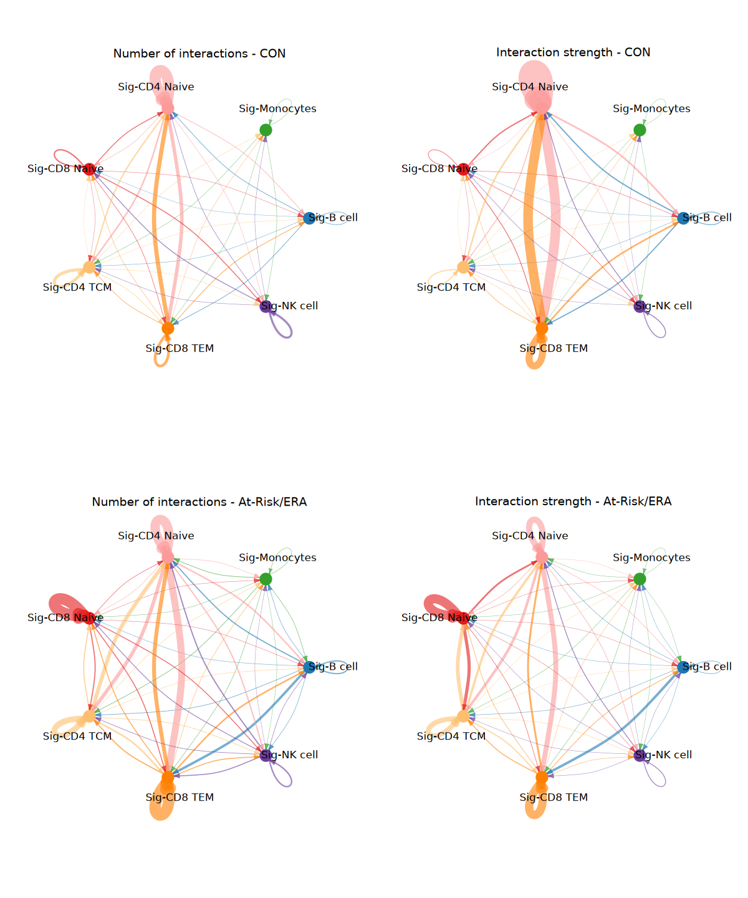
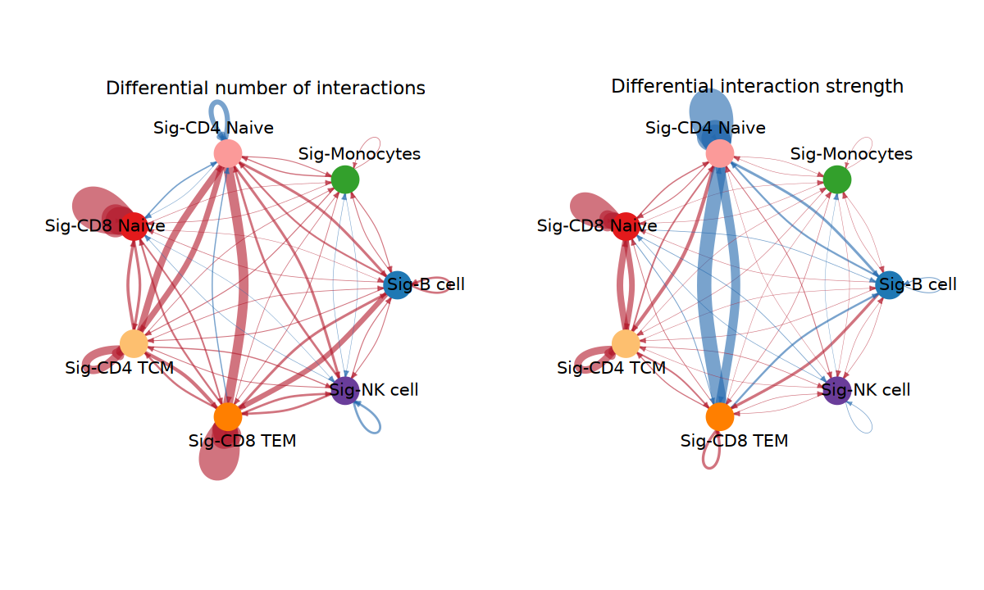
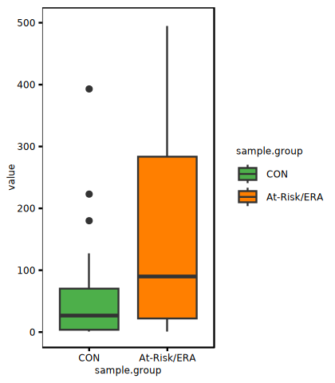
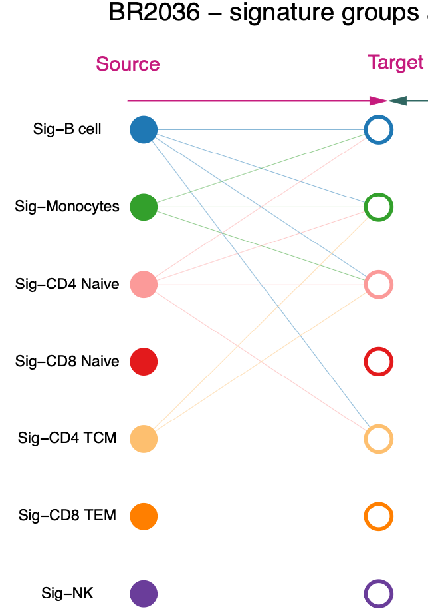
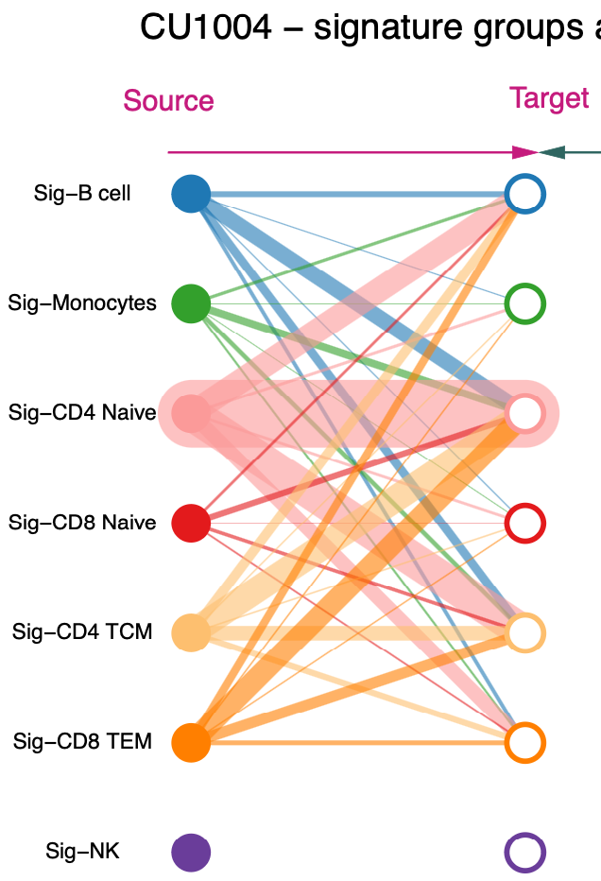
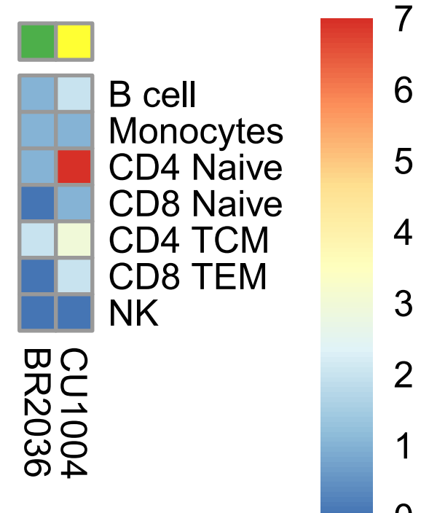
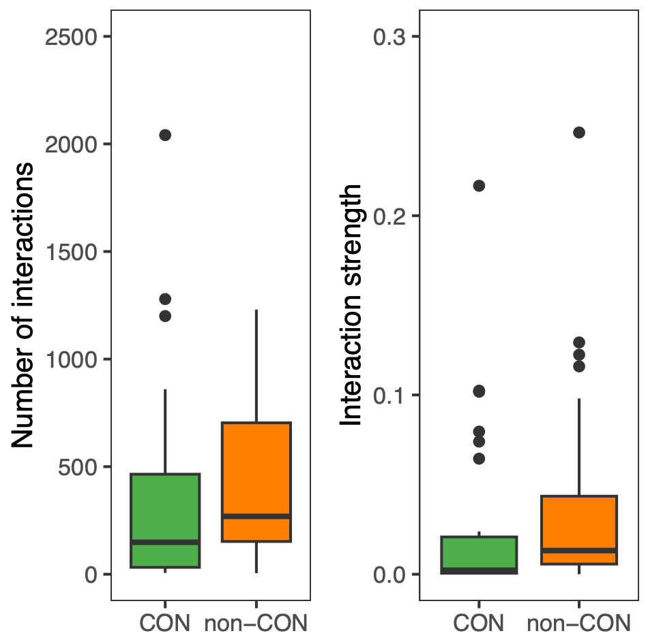
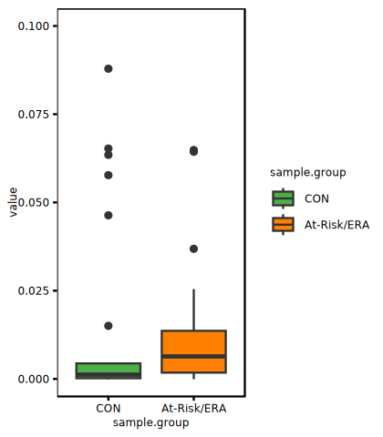
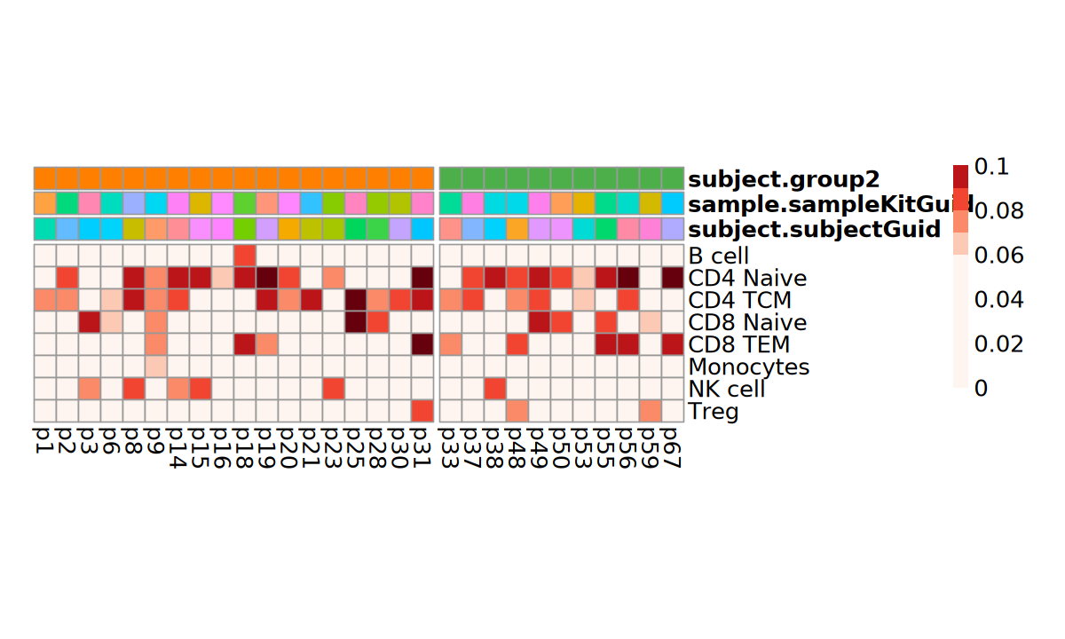
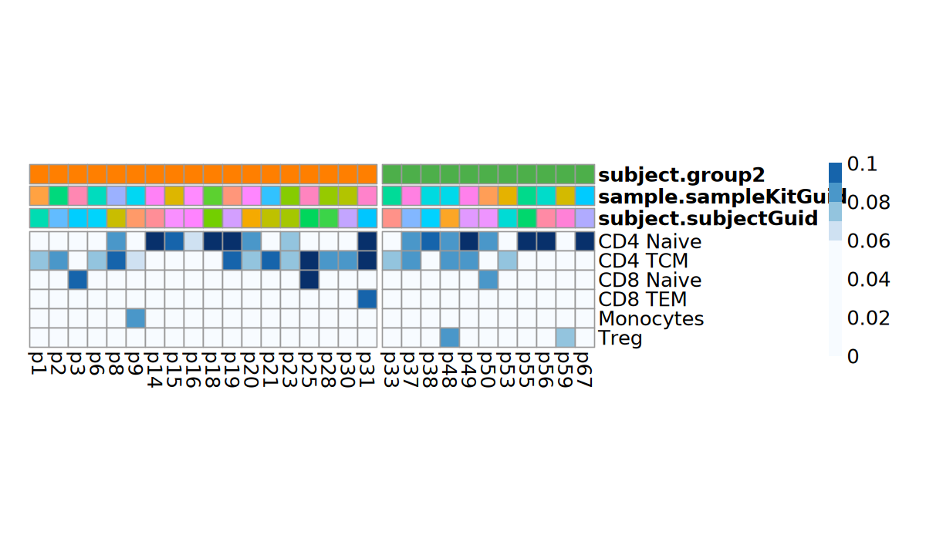
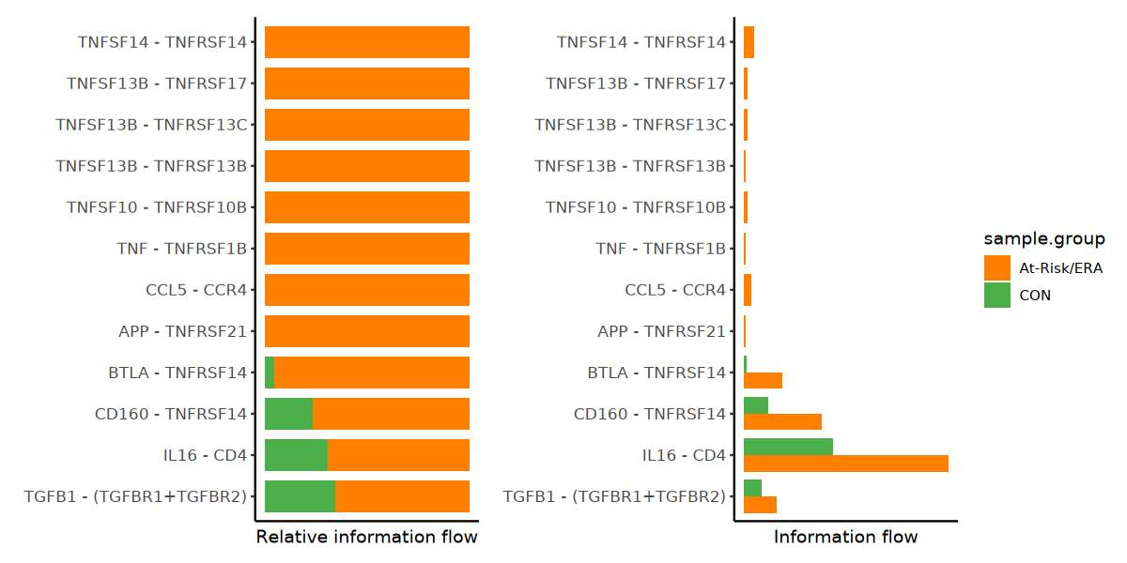
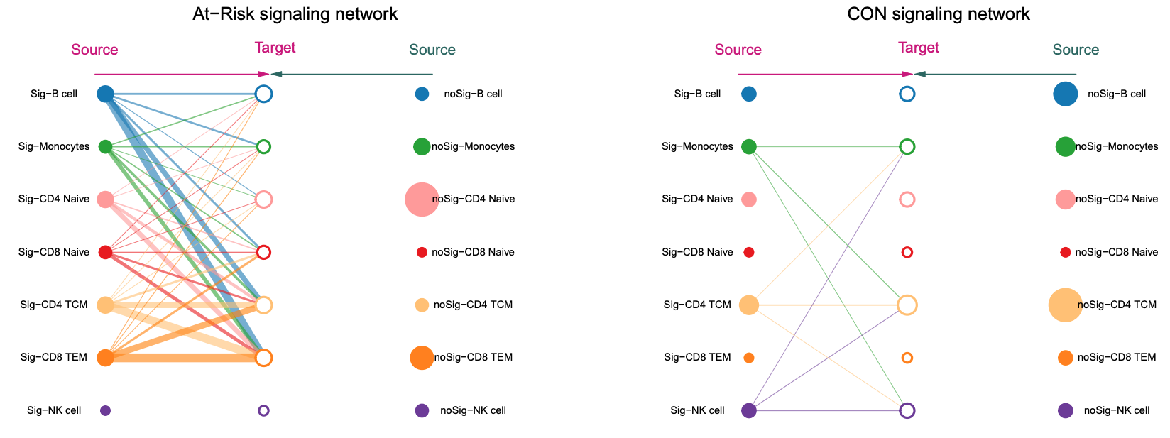
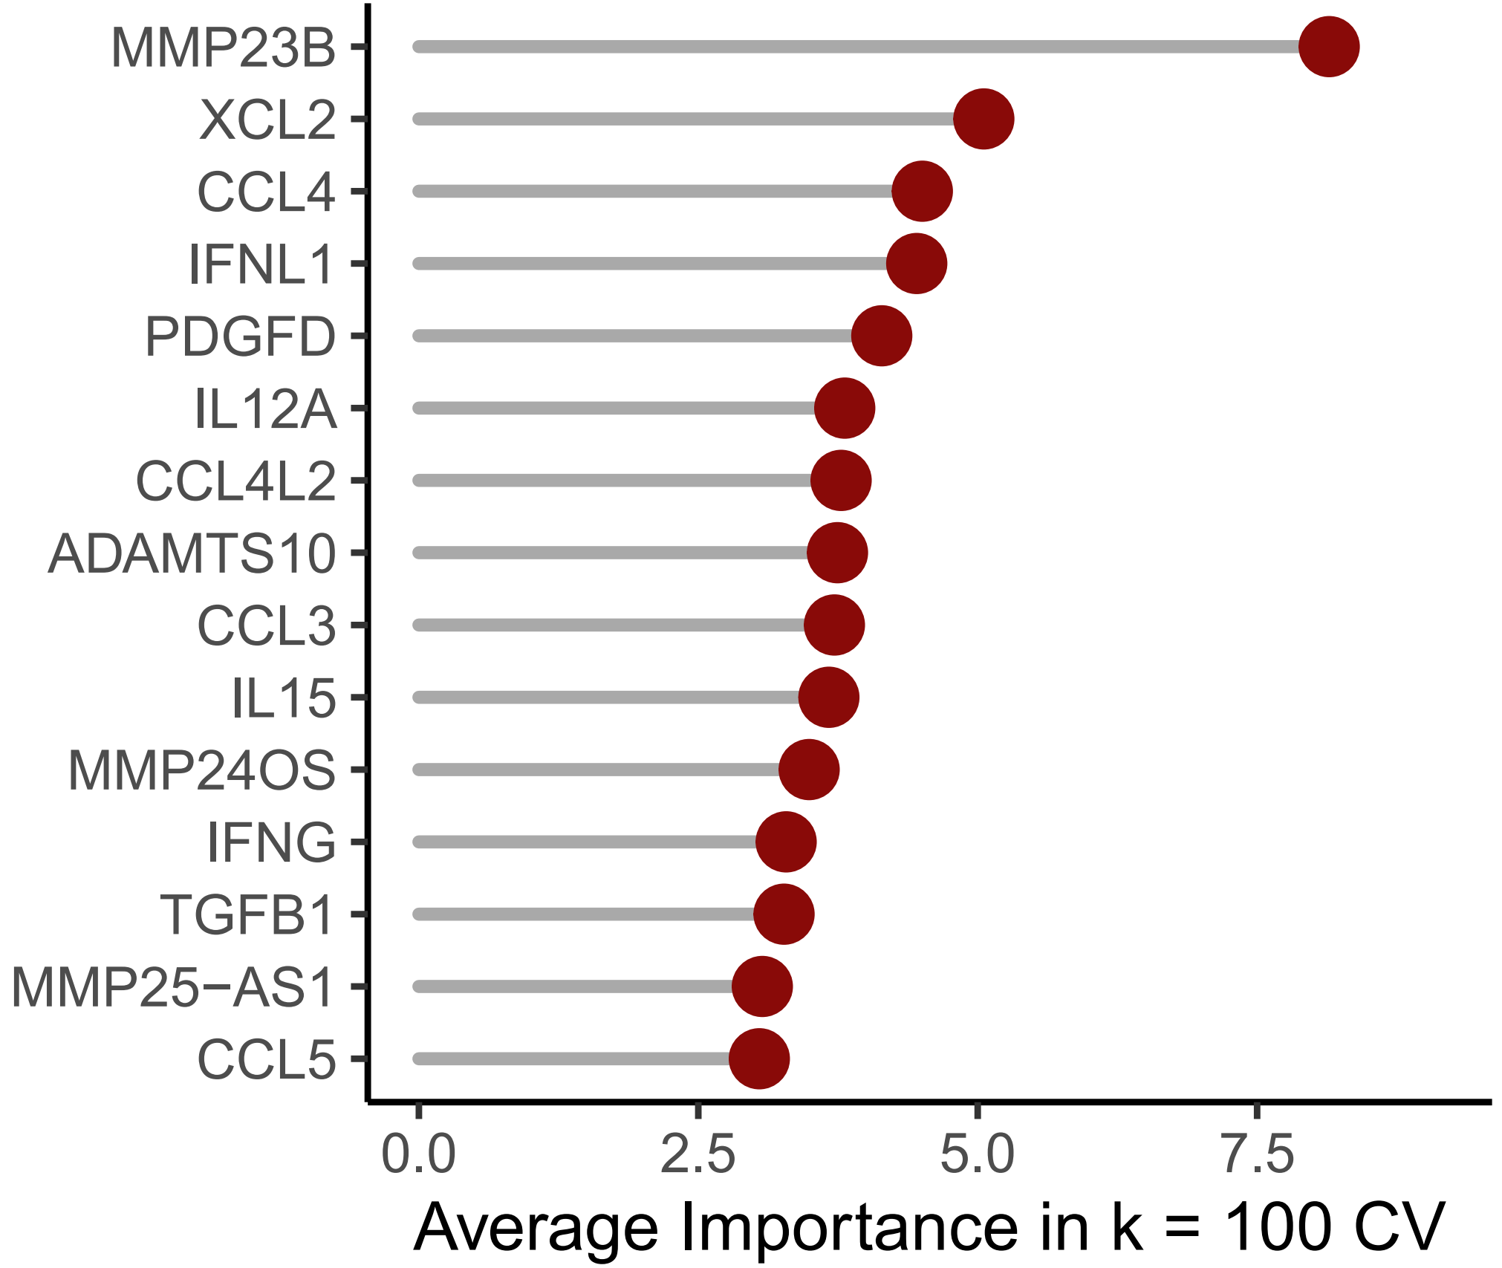
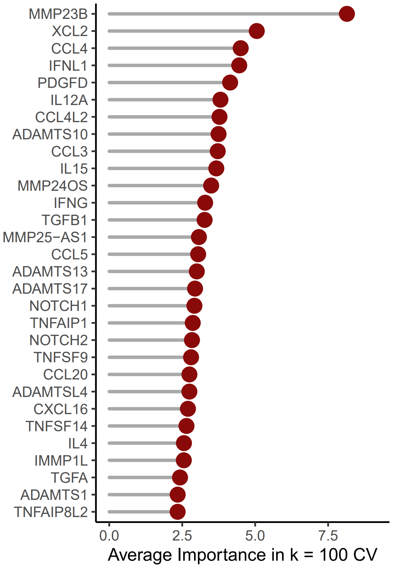
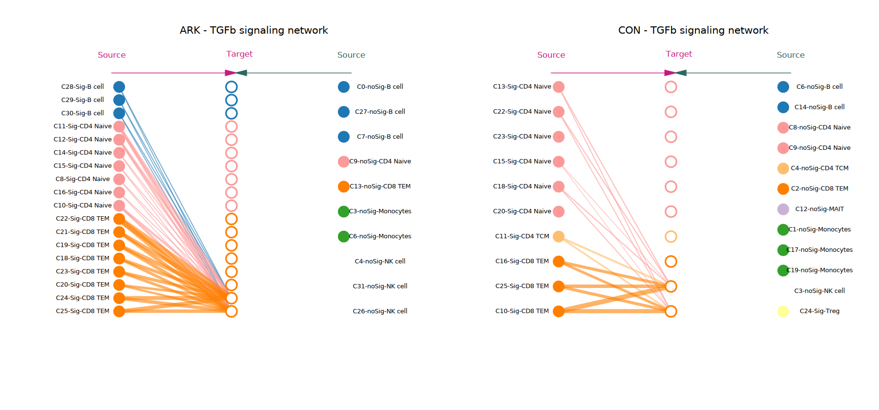
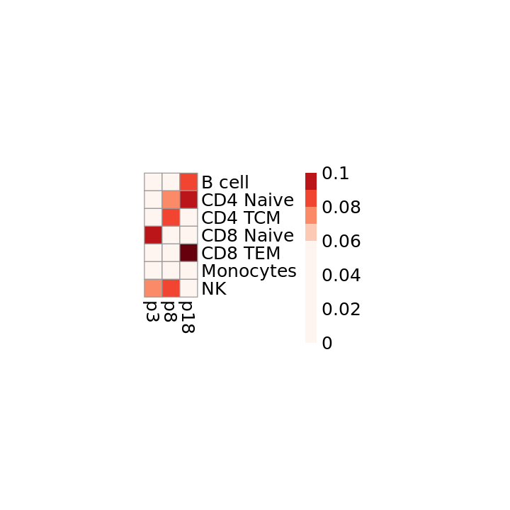
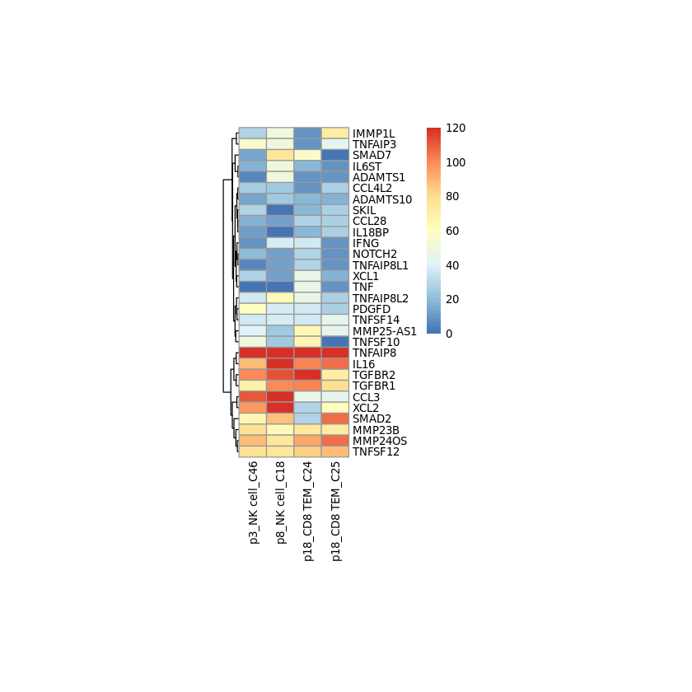
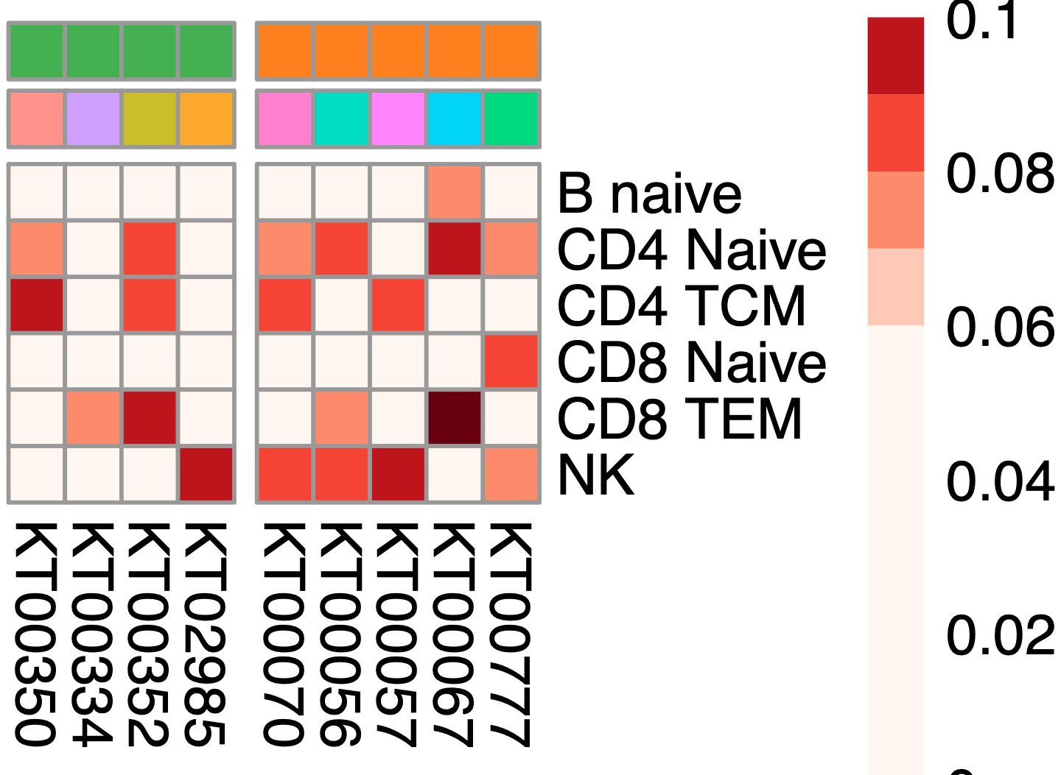
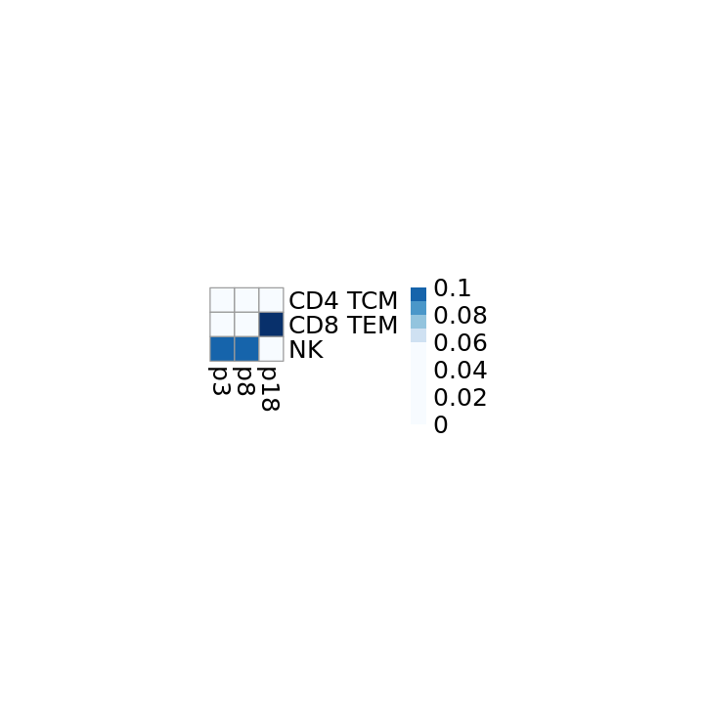

A
Number of interactions between signature clusters in two groups
500
*
400
300
participant 53
participant
53
Number of interactions
participant 9
9
200
Source
Target
Source
Target
100
B cell
7
B cell
0
Monocytes
6
Monocytes
CON
CD4 Naïve
5
CD4 Naïve
At-Risk/ERA
Number of pseudobulk clusters
At-Risk/ERA
CON
At-Risk/ERA vs CON
CD8 Naïve
4
CD8 Naïve
3
B
Network comparison within signature clusters
CD4 TCM
2
CD4 TCM
B
Interaction strength between signature clusters in two groups
CD8 TEM
1
CD8 TEM
NK
0
NK
0.1
**
**
**
0.05
Interaction strength
At-Risk/ERA
CON
0
B cell
CD4 Τ Naive
CON
CD4 TCM
At-Risk/ERA
senders
CD8 Τ Naive
CON At-Risk/ERA
CON At-Risk/ERA
At-Risk/ERA
CON
At-Risk/ERA vs CON
CD8 TEM
Monocytes
NK cell
Representative communication networks
Increased ligand-receptor pairs in At-Risk/ERA
CD4 Τ Naive
C
D
CD4 TCM
receivers
CD8 Τ Naive
p53
p9
TNFSF14 - TNFRSF14
CD8 TEM
Source
Target
Source
Target
TNFSF13B - TNFRSF17
CON
p1
Monocytes
p2
p3
p6
p8
p9
p14
p15
p16
p18
p19
p20
p21
p23
p25
p28
p30
p31
p33
p37
p38
p48
p49
p50
p53
p55
p56
p59
TNFSF13B - TNFRSF13C
At-Risk/ERA
p67
B cell
TNFSF13B - TNFRSF13B
Monocytes
TNFSF10 - TNFRSF10B
TNF - TNFRSF1B
E
Top predictors of classification model
CD4 T Naive
CCL5 - CCR4
CD8 T Naive
APP - TNFRSF21
BTLA - TNFRSF14
CD4 TCM
CD160 - TNFRSF14
IL16 - CD4
CD8 TEM
TGF-β1 - (TGFBR1+TGFBR2)
Relative information flow
Absolute information flow
NK cell
E
TGF-β signaling network comparison
F
Major senders/receivers in TGF-β pathway
G
Receiver cell gene expression induced by TGF-β
Source
p48
Target
Source
p18
Target
IMMP1L
TNFAIP3
SMAD7
IL6ST
ADAMTS1
CCL4L2
ADAMTS10
SKIL
CCL28
IL18BP
IFNG
NOTCH2
TNFAIP8L1
XCL1
TNF
TNFAIP8L2
PDGFD
TNFSF14
MMP25−AS1
TNFSF10
TNFAIP8
IL16
TGFBR2
TGFBR1
CCL3
XCL2
SMAD2
MMP23B
MMP24OS
TNFSF12
B cell – C1
B cell
CD4 T Naive – C1
B cell – C2
CD4 Τ Naive
Outgoing signaling strength
Gene Expression
CD4 T Naive – C2
B cell – C3
CD4 TCM
120
CD4 Τ Naive – C1
senders
CD8 Τ Naive
100
CD4 T Naive – C3
CD4 Τ Naive – C2
0
0.08
CD4 T Naive – C4
CD4 Τ Naive – C3
CD8 TEM
0.06
0.1
80
SMAD7
IFNG
MMP11
THBS1
SKIL
SMAD3
CDKN2C
SMAD2
TGFBR1
TGFBR2
CD4 T Naive – C5
CD4 Τ Naive – C4
Monocytes
60
CD4 Τ Naive – C5
NK cell
40
CD4 T Naive – C6
CD4 Τ Naive – C6
CD4 TCM – C1
CD4 Τ Naive – C7
CD4 TCM
Incoming signaling strength
20
CD8 TEM – C1
0
CD8 TEM – C1
CD8 TEM – C2
receivers
CD8 TEM
CD8 TEM – C2
CD8 TEM – C3
NK cell
CD8 TEM – C4
0
0.08
CD8 TEM – C3
CD8 TEM – C5
p3
0.06
0.1
p8
CD8 TEM – C6
p18
CD8 TEM – C7
CD8 TEM – C8
p3-NK
p8-NK
p18-CD8 TEM-C7
p18-CD8 TEM-C8
Notes:
CCL4, PDGFD, IL12A, IL15, TGFB1, CCL5, NOTCH1, CCL20, CXCL16, TNFSF14

Slide 5
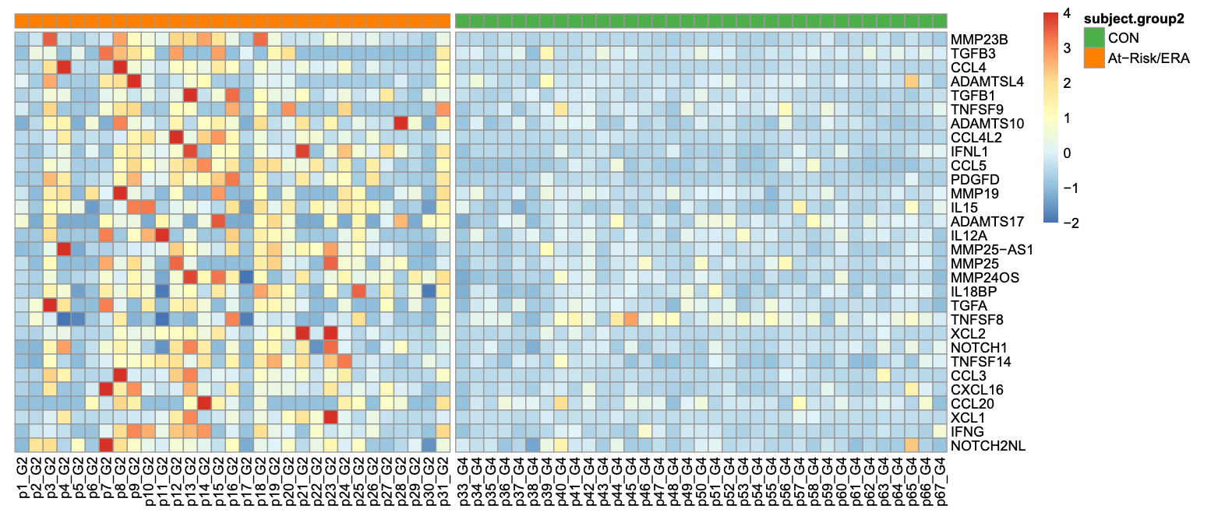
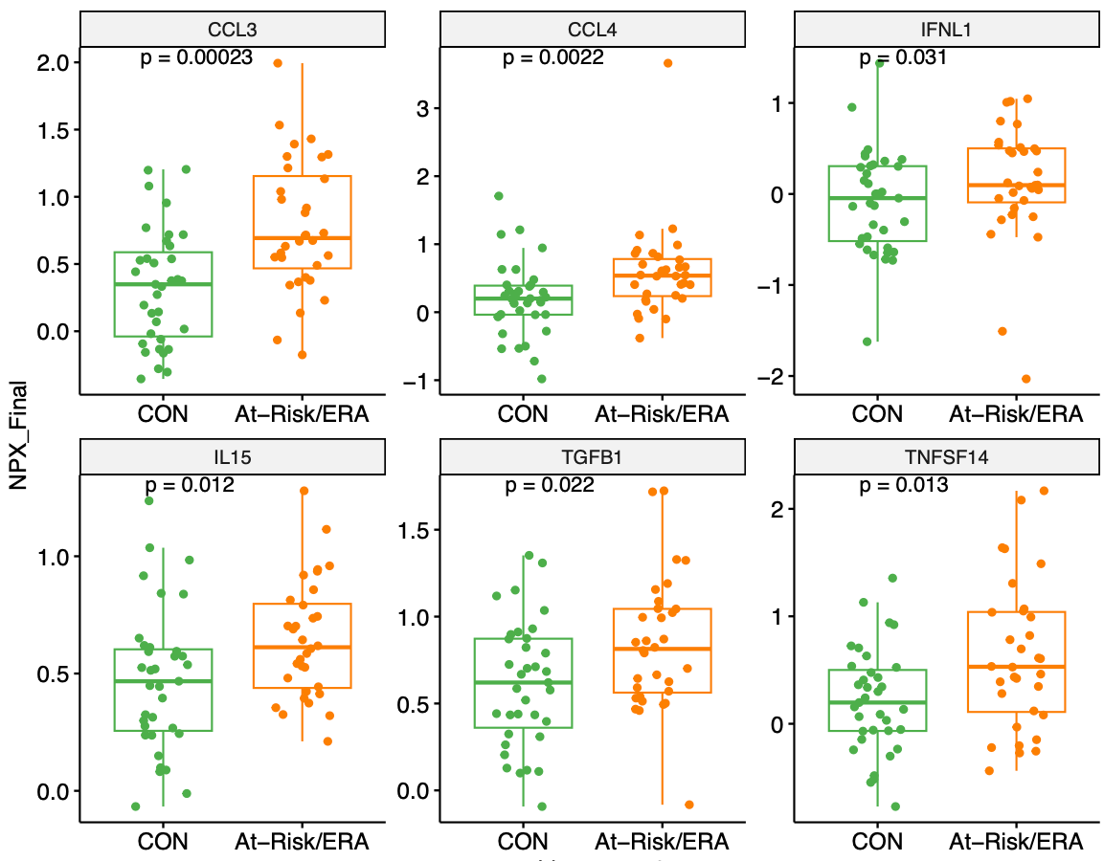
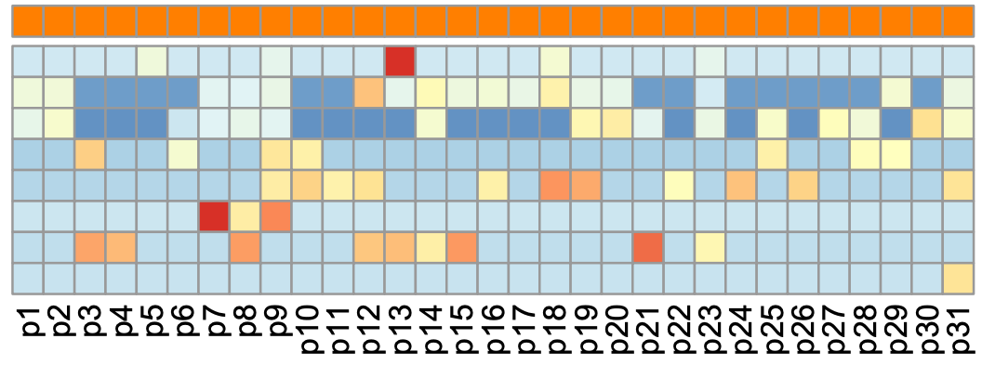
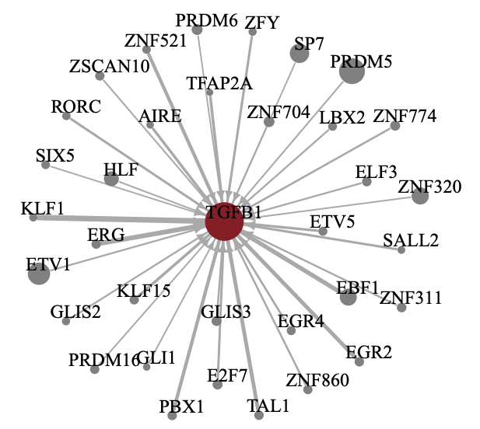
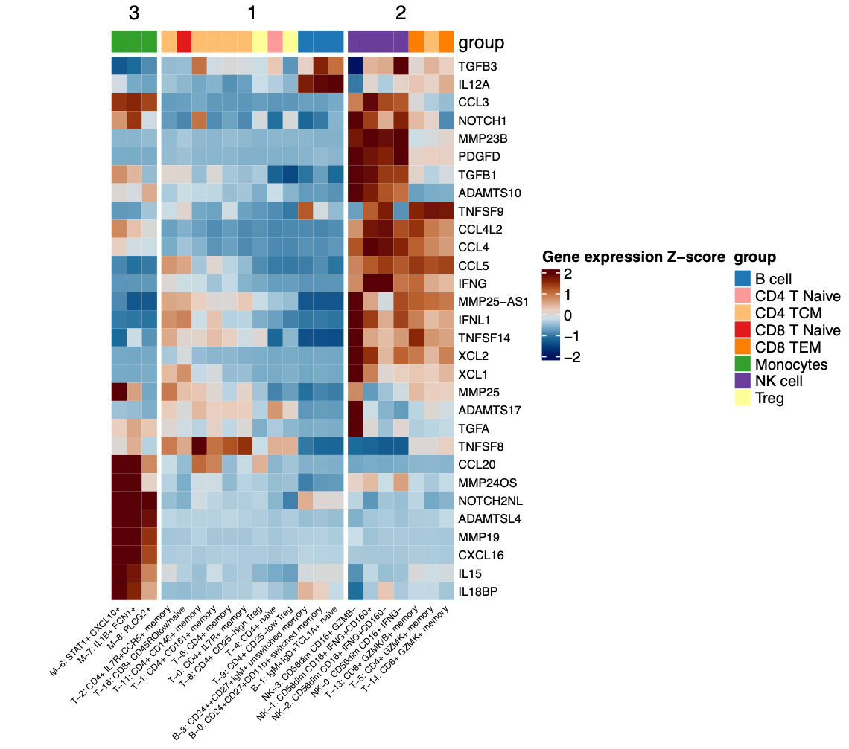



A
Top 30 mediators’ gene expression levels
B
Protein expression of top mediators
At-Risk/ERA
CON
CCL3
CCL4
IFN-λ1
MMP23B
TGFB3
CCL4
ADAMTSL4
TGFB1
TNFSF9
ADAMTS10
CCL4L2
IFNL1
CCL5
PDGFD
MMP19
IL15
ADAMTS17
IL12A
MMP25-AS1
MMP25
MMP24OS
IL18BP
TGFA
TNFSF8
XCL2
NOTCH1
TNFSF14
CCL3
CXCL16
CCL20
XCL1
IFNG
NOTCH2NL
1.5
****
3
***
1
**
1.0
2
0
0.5
1
-1
0.0
0
-2
Normalized protein expression
-1
IL-15
TGF-β1
TNFSF14
1.0
**
1.5
**
2
**
0.5
1.0
1
0.5
0
0.0
0.0
CON
At-Risk/ERA
C
TGFB1 gene expression levels across At-Risk and ERAs
B cell
CD4 T Naive
CD4 TCM
CD8 T Naive
CD8 TEM
Monocytes
NK cell
Normalized gene expression
p1
p2
p3
p4
p5
p6
p7
p8
p9
p10
p11
p12
p13
p14
p15
p16
p17
p18
p19
p20
p21
p22
p23
p24
p25
p26
p27
p28
p29
p30
-2
0
2
4
p31
G
Top regulators of TGFB1
D
Top 30 mediators’ gene expression levels in synovial tissues across clusters
E
Top 30 mediators’ gene expression levels in synovial tissues across individuals
TGFB3
IL12A
CCL3
NOTCH1
MMP23B
PDGFD
TGFB1
ADAMTS10
TNFSF9
CCL4L2
CCL4
CCL5
IFNG
MMP25-AS1
IFNL1
TNFSF14
XCL2
XCL1
MMP25
ADAMTS17
TGFA
TNFSF8
CCL20
MMP24OS
NOTCH2NL
ADAMTSL4
MMP19
CXCL16
IL15
IL18BP
Gene expression
Z-score
TNFSF8 TGFB1
NOTCH1
TGFA
MMP24OS
IL18BP
CCL3
CCL20
MMP19
IL15
CXCL16
ADAMTSL4
NOTCH2NL
ADAMTS10
TNFSF9
CCL4
CCL4L2
IFNG
CCL5
XCL2
PDGFD
MMP23B
TGFB3
ADAMTS17 MMP25-AS1
TNFSF14
XCL1
IFNL1
MMP25
IL12A
2
1
0
-1
-2
Cell type
B cell
CD4 T Naive
CD4 TCM
CD8 T Naive
CD8 TEM
Monocytes
NK cell
A
Gene TGFB1 expression level
****
F
Mean gene expression levels in cell types across individuals
G
Estimated gene expression in monocytes from clinical trial on abatacept response
900
600
NK cell
CD4 T Naive
CD8 TEM
CD4 TCM
CD8 T Naive
Monocytes
B cell
Abatacept responder
Abatacept non-responder
max_rna_expr
MMP19
300
ADAMTSL4
2
TNFSF8
IL15
1
MMP25
Gene expression z-score
CON At-Risk/ERA
TGFA
0
MMP24OS
-1
IL18BP
TNFSF14
-2
CXCL16
TGFB1
NOTCH1

Slide 6






A
Signature cell types distribution in converters over time
C
Expression patterns by signature cell types at the time of conversion
CD8 Naive
CD4 Naive
CD8 TEM
CD4 TCM
NK cell
B cell
Monocytes
TGFA
XCL1
XCL2
CCL3
CCL4L2
MMP23B
MMP25-AS1
MMP24OS
TGFB1
CCL4
IL12A
CCL5
IFNG
TNFSF14
IL15
PDGFD
MMP25
IFNL1
MMP19
ADAMTSL4
CXCL16
CCL20
IL18BP
TNFSF9
ADAMTS17
TNFSF8
TGFB3
ADAMTS10
NOTCH1
p10
p11
p12
p16
p21
p25
p26
p28
p29
p32
p69
p70
p71
Visit
baseline
middle visit
conversion
# of signature clusters
0
2
4
6
8
B
Key mediator expression over time
ADAMTS10
ADAMTS17
ADAMTSL4
CCL20
CCL3
CCL4
CCL4L2
CCL5
CXCL16
IFNG
IFNL1
IL12A
IL15
IL18BP
MMP19
MMP23B
MMP24OS
MMP25
MMP25-AS1
NOTCH1
PDGFD
TGFA
TGFB1
TGFB3
TNFSF14
TNFSF8
TNFSF9
XCL1
XCL2
CD8 Naive
CD4 TCM
Monocytes
B cell
CD4 Naïve
NK cell
CD8 TEM
Gene expression z-score
-2
-1
0
1
2
p10
p11
p12
p16
p21
p25
p26
p28
p29
p32
p69
p70
p71
Gene expression
0
5
10
15
20
25
patient 1
D
Proposed hypothesis to RA onset
patient 2
Senders/
Receivers migrate to joint
Epigenetic remodeling in multiple cell types
Enhanced & individualized
cellular communication
Disease Progression
Healthy
B cell
Monocytes
T Cell
T Cell
Conversion
Rheumatoid
Arthritis
B cell
B cell
CD4 T Naive
Common
mediators
CD4 T Naive
CD4 T Naive
RA Signature TFs/pathways
NK
Monocytes
Monocytes
Stable mediator expression
(e.g., TGFB1, CCL5)
CD4 TCM
CD8 T Naive
NK
NK
CD8 TEM
B cell
CD8 TEM
Sender cells
express cytokines regulated by RA signature TFs
Receiver cells
activated by cytokines produced by sender cells
Evolving signature cell type
Risk factors
Second Hit
(e.g. DNA methylation)

Slide 7












A
QC metrics for scRNA-seq
A
scRNA-seq and scATAC-seq of one control sample
scRNA-seq only
scATAC-seq only
B memory
B naive
CD14 Mono
CD16 Mono
CD4 T Naive
CD4 TCM
CD8 T Naive
CD8 TEM
MAIT
NK
Treg
B
UMAP plots from all scRNA-seq cells
UMAP 2
UMAP 2
Sample
Cell types
UMAP 1
UMAP 1
B
Co-embedding of scRNA-seq and scATAC-seq in one control sample
colored by cell types
colored by assay
C
QC metrics for scATAC-seq
scATAC-seq
scRNA-seq
UMAP 2
UMAP 2
D
Cells distribution in CD4 TCM cluster
Treg
MAIT
D
UMAP plots from all scATAC-seq cells
E
Cluster purity across cell types
UMAP 1
UMAP 1
CD8 TEM
CD4 T Naive
Sample
Cell types
1.0
CD8 T Naive
0.8
CD4 TCM
purity
0.6
0.4
B intermediate
B memory
B naive
CD14 Mono
CD16 Mono
CD4 T Naive
CD4 TCM
CD8 T Naive
CD8 TEM
cDC2
MAIT
NK
NK_CD56bright
Treg
Notes:
B112_PB00447

Slide 8












A
Dimensional reduction
B
First and second PCs are related cell types
C
Choose distance metric and number of groups
1
B intermediate
B memory
B naive
CD14 Mono
CD16 Mono
CD4 T Naive
CD4 Proliferating
CD4 TCM
CD4 TEM
CD8 T Naive
CD8 TCM
CD8 TEM
cDC2
Eryth
gdT
HSPC
MAIT
NK
NK_CD56bright
pDC
Plasmablast
Treg
K=5, Pearson Correlation
0.75
PC=500
distance metrics
Cumulative proportion of variance explained
0.10
Euclidean
0.50
PC2: 5% variance
average silhouette width
Kendall
0.25
0.05
Manhattan
At-Risk
Pearson
CON
0
Spearman
0
250
500
750
1000
PC1: 6% variance
ERA
5
10
Principal Component
number of groups K
D
Kmeans clustering: all TFs
E
Kmeans group-specific TFs
G1
G2
G3
G4
G5
Normalized PageRank
4
2
0
-2
H
G2 clusters ratio per cell type
I
Downstream genes of SUMOylation-related TFs
F
Overlap of G2-specific TFs
At-Risk
ERA
CON
38
398
4
At-Risk/ERA
G
Overlap of G2-specific pathways
CON
At-Risk/ERA
J
TFs in signature pathways
At-Risk
ERA
CON
HEY1, HEY2, HES1
2
18
2
At-Risk/ERA
Percentage of G2 clusters per cell type
16
K
G2-specific TFs whose regulatees enriched in At-Risk/ERA signature pathways

Slide 9














A
Heatmap of participants in G2 across cell types
ERA
At-Risk
CON
Number of G2 clusters
CD8 T Naive
CD4 T Naive
CD8 TEM
CD4 TCM
NK cell
B cell
Monocytes
20
ARID3C
ARX
BARHL2
BCL6B
CDX1
DBX2
DLX1
DLX2
DLX3
DLX5
DPF1
DUX4
E2F7
E2F8
EGR4
ELF5
EMX1
EN2
ETV1
ETV3L
ETV4
FOXD4L1
FOXD4L5
FOXL2
FOXP2
GCM1
GCM2
GLIS2
HAND1
HKR1
HMX2
HOXA13
HOXB13
IRX5
KLF14
KLF15
LHX8
LIN28A
MEF2B
MIXL1
MLXIPL
MNX1
NFE4
NKX2-2
NOBOX
NOTO
PAX2
PAX4
PAX7
PHOX2A
POU1F1
POU2F3
POU3F2
POU3F3
POU3F4
PROP1
PRRX1
PRRX2
RAX2
RHOXF2
RHOXF2B
SHOX
SHOX2
SIX1
SIX4
SOHLH2
SP7
SP9
TBPL2
TFAP2A
TFAP2B
TFAP2C
TFDP3
TLX2
TP63
VSX2
WT1
YBX2
ZIC1
ZNF177
ZNF214
ZNF304
ZNF454
15
10
5
C
0
Representative pathways of Kmeans group specific regulatees
Nuclear Receptor transcription pathway
Interferon signaling
TNF signaling
Regulation of RUNX2 expression and activity
SUMOylation
Signaling by ROBO receptors
G alpha (q) signaling events
B
Established RA signature TFs
C
Major senders/receivers across patients
Normalized PageRank
B cell
CD4 T Naive
4
senders
CD4 TCM
2
CD8 T Naive
0
CD8 TEM
-2
Monocytes
NK cell
B
G2-specific TFs whose regulatees enriched in At-Risk/ERA signature pathways
Established RA
signature TFs
B cell
CD4 T Naive
receivers
CD4 TCM
TNF
SUMO
RUNX2
ROBO
NOTCH3
NF-kB
beta-catenin
G1
G2
G3
G5
CD8 T Naive
CD8 TEM
Monocytes
E
Regulatees in signature pathways
p10
NK cell
p11
p12
p13
p14
p15
p16
p17
p18
p19
p20
p21
p22
p23
p24
p25
p26
p27
p28
p29
p30
p1
p31
p2
p3
p4
p5
p6
p7
p8
p9
Intersection
size
30
Outgoing signaling strength
Incoming signaling strength
20
Established RA
signature clusters
10
0
0.2
0.4
0.6
0.8
1
0
0.2
0.4
0.6
0.8
1
0
MMP23B
TGFB3
CCL4
ADAMTSL4
TGFB1
TNFSF9
ADAMTS10
CCL4L2
IFNL1
CCL5
PDGFD
MMP19
IL15
ADAMTS17
IL12A
MMP25-AS1
MMP25
MMP24OS
IL18BP
TGFA
TNFSF8
XCL2
NOTCH1
TNFSF14
CCL3
CXCL16
CCL20
XCL1
IFNG
NOTCH2NL
ROBO
SUMO
NF-kB
RUNX2
TNF
D
Overall signaling network comparison
E
Cell type distribution of top 30 mediators
CD8 T Naive
1.5
CD4 T Naive
9000
CD4 TCM
B cell
1.0
Monocytes
Set size
6000
Interaction strength
NK cell
Number of interactions
CD8 TEM
D
TFs in signature pathways
3000
0.5
Normalized probability
0
0
0.4
CON At-Risk/ERA
CON At-Risk/ERA
0.2
HEY1, HEY2, HES1
MMP23B
TGFB3
CCL4
ADAMTSL4
TGFB1
TNFSF9
ADAMTS10
CCL4L2
IFNL1
CCL5
PDGFD
MMP19
IL15
ADAMTS17
IL12A
MMP25-AS1
MMP25
MMP24OS
IL18BP
TGFA
TNFSF8
XCL2
NOTCH1
TNFSF14
CCL3
CXCL16
CCL20
XCL1
IFNG
NOTCH2NL
0
SATB2, AR
Intersection
size
10
SOX9
F
Classification model performance
G
Top 30 predictors of classification model
5
1.0
0.9
0.8
0.7
0.6
0.5
0
RUNX2
SUMO
YAP Wnt
NOTCH3
6
4
Group
Average Importance
Mean +/ SD Accuracy
test
train
2
Set size
0
0
20
40
60
Number of Predictors
Notes:
http://localhost:8900/lab/workspaces/auto-e/tree/altra/post-analysis/new_established_RA/only_RA/hp_normed2_all_TFs_k6_hclust_5RAs.pdf

Slide 10



















A
IL16 signaling network comparison
B
Major senders/receivers in IL16 pathway
C
Receiver cell gene expression induced by IL16
Source
p48
Target
Source
p31
Target
B cell
B
Differential cellular network between two groups
CD4 Τ Naive – C1
CD4 T Naive – C1
CD4 Τ Naive
TNFSF13B
TGFBI
TNFAIP2
CCL4
TNFAIP3
TNFAIP8L2
IL2RA
TNF
IMMP1L
CCL28
IL2RB
NOTCH2
TNFSF14
TNFSF8
IL23A
SKP2
MMP25−AS1
IMMP2L
TNFAIP8L1
IL16
TNFSF10
TGFB1
TIMP1
CCL5
CDKN1B
IL32
TNFAIP8
IL6ST
TNFSF12
MMP24OS
CD4 T Naive – C2
CD4 TCM
CD4 Τ Naive – C2
CD4 T Naive – C3
senders
CD8 Τ Naive
CD4 Τ Naive – C3
CD4 T Naive – C4
CD8 TEM
CD4 T Naive – C5
Monocytes
CD4 Τ Naive – C4
CD4 TCM – C1
NK cell
CD4 TCM – C2
CD4 Τ Naive – C5
CD4 TCM – C3
CD4 TCM – C4
CD4 Τ Naive
CD4 Τ Naive – C6
CD4 TCM – C5
CD4 TCM
CD8 TEM – C1
p9_CD4 TCM
p7_CD4 TCM
p6_CD4 TCM
p31_CD8 TEM
p8_CD4 TCM
p16_CD4 Naive
p19_CD4 TCM
p20_CD4 TCM
p1_CD4 TCM
p15_CD4 Naive
p21_CD4 TCM
p18_CD4 Naive
p28_CD4 TCM
p14_CD4 Naive
p2_CD4 TCM
p31_CD4 TCM
p25_CD4 TCM
p30_CD4 TCM
p19_CD4 Naive
p17_CD4 Naive
p1_CD4 Naive
p25_CD8 Naive
p2_CD4 Naive
p8_CD4 Naive
p23_CD4 Naive
p31_CD4 Naive
p20_CD4 Naive
p3_CD8 Naive
p23_CD4 TCM
p7_CD4 Naive
p9_Monocytes
CD4 TCM – C1
CD8 TEM – C2
receivers
CD8 Τ Naive
CD8 TEM – C3
CD8 TEM
CD8 TEM – C1
CD8 TEM – C4
Monocytes
CD8 TEM – C5
CD8 TEM – C2
CD8 TEM – C6
p1
p2
p3
p6
p7
p8
p9
p25
p28
p30
p14
p31
p15
p16
p17
p18
p19
p20
p21
CD8 TEM – C3
CD8 TEM – C7
p23
CD8 TEM – C8
D
CD160 signaling network comparison
E
Major senders/receivers in CD160 pathway
F
Receiver cell gene expression induced by CD160
Source
p55
Target
Source
p18
Target
At-Risk/ERA
E
CCL5 signaling network comparison
B cell – C1
B cell – C1
participant 25
participant 40
D
CD4 Τ Naive – C1
B cell – C2
CD4 TCM
CD4 Τ Naive – C2
B cell – C3
senders
CD8 TEM
Source
Target
Source
Target
CD4 Τ Naive – C3
CD4 Τ Naive – C1
CD4 Τ Naive – C4
CD4 Τ Naive – C2
NK cell
CD4 Τ Naive – C3
CD4 Τ Naive – C5
CD4 Τ Naive – C4
B cell
CD4 Τ Naive – C6
CD4 Τ Naive – C5
CD4 Τ Naive – C7
CD4 Τ Naive – C6
CD4 Τ Naive
CD8 Τ Naive – C1
CD4 Τ Naive – C7
CD4 TCM
CD8 TEM – C1
CD8 TEM – C1
receivers
CD8 TEM – C2
CD8 Τ Naive
CD8 TEM – C2
CD8 TEM – C3
CD8 TEM
CD8 TEM – C3
CD8 TEM – C4
CD8 TEM – C4
CD8 TEM – C5
NK cell
CD8 TEM – C5
CD8 TEM – C6
p3
p4
CD8 TEM – C7
p8
p14
p15
p18
p21
IL16 signaling network comparison
CD8 TEM – C6
CD8 TEM – C8
p24
p55
p9
H
Major senders/receivers in BTLA pathway
I
Receiver cell gene expression induced by BTLA
Source
Target
Source
Target
G
BTLA signaling network comparison
B cell – C1
B cell – C1
Source
p51
Target
Source
p18
Target
At-Risk/ERA
CD4 T Naive – C1
B cell – C2
B cell – C1
B cell – C1
CD4 T Naive – C2
B cell – C2
senders
B cell
B cell – C3
CD4 T Naive – C1
CD4 Τ Naive – C1
CD4 T Naive – C3
CD4 Τ Naive – C2
B cell
CD4 Τ Naive – C3
CD4 Τ Naive
CD4 T Naive – C4
CD4 Τ Naive – C4
CD4 T Naive – C2
CD4 ΤCM– C1
CD4 Τ Naive – C5
CD4 TCM
**
**
CD4 Τ Naive – C6
receivers
CD8 Τ Naive
CD4 T Naive – C5
CD4 Τ Naive – C7
CD4 TCM – C1
CD8 TEM – C1
CD8 TEM
CD4 T Naive – C6
CD8 TEM – C2
Monocytes
CD8 TEM – C3
CD8 TEM – C4
NK cell
CD4 T Naive – C7
CD4 TCM – C2
CD8 TEM – C5
CD8 TEM – C1
CD8 TEM – C6
p9
p18
CD8 T Naive – C1
CD8 TEM – C7
p23
CD8 TEM – C1
CD8 T Naive – C1
CD8 TEM – C8
CD8 TEM – C2
CD8 TEM – C1
CD8 TEM – C3
CD8 TEM – C2
J
Choose distance metric and number of groups
K
Disease state distribution across Kmeans group
L
Clustering by gene expression
CD8 TEM – C4
Monocytes – C1
K=5, Pearson Correlation
G1
G2
G3
G4
G5
CON At-Risk/ERA
CON At-Risk/ERA
CD8 TEM – C5
0.20
CD8 TEM – C6
pDC – C1
distance metrics
Euclidean
0.10
Kendall
average silhouette width
Manhattan
0
Pearson
Spearman
5
10
number of groups K
E
Notes:
https://www.ncbi.nlm.nih.gov/pmc/articles/PMC10439836/

Slide 11



A
Choose distance metric and number of groups
B
Kmeans clustering: all TFs
K=4, Pearson Correlation
G1
G2
G3
G4
0.20
distance metrics
Normalized PageRank
0.15
Euclidean
4
0.10
Kendall
average silhouette width
Manhattan
2
0.05
Pearson
0
0
Spearman
-2
4
6
8
10
number of groups K
C
Cell type distribution
D
Signature TF overlap
E
Enriched pathways overlap
All
0.6
Longitudinal
Cross-sectional
Longitudinal
Cross-sectional
G1
G2
0.4
Percent of clusters
G3
NK
G4
0.2
94
309
100
5
51
3
B naive
MAIT
Treg
0
CD8 TEM
B memory
CD4 TCM
CD14 Mono
CD16 Mono
CD4 T Naive
B intermediate
CD8 T Naive
NK_CD56bright
Notes:
Allen server: private/paper_figures/longitudinal/kmeans_param.pdf

Slide 12



Fig. xx Similar signature in external established RA dataset
To explore whether the At-Risk/ERA signature persists in later development stage of RA, we gathered five established RA PBMC samples and applied the same analysis pipeline to get the PageRank scores of TFs across pseudo-bulk clusters from established RAs. Hierarchical clustering demonstrates that a group of TFs have high PageRank scores in specific clusters (Supplementary Fig. xxA), referred to as “Established RA signature TFs” and “Established RA signature clusters”. All the five RA participants had the signature in at least one cell type although the combinations of cell types were diverse (Supplementary Fig. xxB). Participants RA3, RA4, and RA5 showed similar signature profiles, in which CD4 T Naive, CD14 Mono, and NK cells were enriched. Comparison of signature TFs identified from At-Risk/ERA and established RA datasets showed a significant overlap (Supplementary Fig. xxC) as well as the enriched Reactome pathways (Supplementary Fig. xxD). All the signature pathways identified in At-Risk/ERA dataset were recovered in the established RA dataset. To further confirm the At-Risk/ERA signature presence in established RAs, we trained a random forest classification model to distinguish signature clusters and non-signature clusters. At-Risk/ERA TF PageRank scores were used as features and clusters from At-Risk/ERA dataset were used as samples. Mean accuracy is 0.94$±$0.01 over 20 cross-validations for both test and train groups (Supplementary Fig. xxE). The trained model on the external established RA samples showed good performance with accuracy as 0.91 (Supplementary Fig. xxF).
B
Heatmap of RAs in signature clusters
CD8 TEM
6
CD4 TEM
5
CD4 TCM
4
Number of signature clusters
CD4 T Naive
3
CD14 Mono
2
NK
1
RA1
0
RA2
RA3
RA4
RA5
C
Signature TF overlap
Established RA
At-Risk/ERA
94
276
157
D
Enriched pathways overlap
Established RA
At-Risk/ERA
E
Random forest classification model
F
Prediction on established RA dataset
5
27
19
0.95
0.90
0.85
0.80
0.75
sig
31
8
Freq
metric | value
accuracy | 0.91
sensitivity | 1
specificity | 0.79
Mean +/ SD Accuracy (k=20 CV)
Group
prediction
40
test
train
20
no-sig
0
50
0
0
10
20
30
sig
no-sig
Number of Predictors
reference
Fig. xx Signature confirmation in external established RA dataset. (A) Hierarchical clustering of pseudo-bulk clusters from five established RA samples. The heatmap shows the normalized PageRank scores of all TFs across all clusters, including B naive, CD14 Mono, CD4 CTL, CD4 Naive, CD4 TCM, CD4 TEM, CD8 Naive, CD8 TEM, and NK cells. A group of TFs are significantly active in a group of clusters, referred to as “Established RA signature TFs” and “Established RA signature clusters”, marked by red boxes. (B) Heatmap of established RA participants in signature clusters across cell types. All the RA participants had the signature in at least one cell type. The signatures were enriched in CD4 T Naive, CD14 Mono and NK cells. (C, D) Venn diagram showing the overlap of signature transcription factors (C) and signature pathways (D) between established RA and At-Risk/ERA groups. (E) Performance of a classification model to distinguish signature (sig) clusters from non-signature (no-sig) clusters using a varying number of predictors. The model was trained on the At-Risk/ERA dataset and the plot displays mean accuracy with standard deviation over 20 cross-validations for both test and train groups. (F) Confusion matrix for prediction on the established RA dataset.
Notes:
K=6
~/altra/post-analysis/new_established_RA/only_RA/hp_normed2_all_TFs_k6_hclust_5RAs.pdf

